Slide 1
Distortion-Free
Camera Calibration
Bingcheng Yang
May Solutions LLC
2018-11-10 Original
2020-02-10 Update

Slide 2
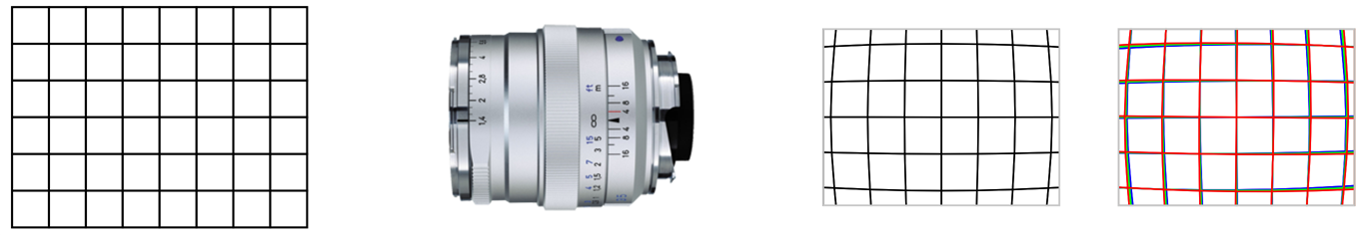
Introduction
Geometry distortion
Chromatic distortion
Mono sensor
Color sensor
Object
Lens
Images
All lens optics cause distortions in imaging systems.
  Geometry distortion.
  Chromatic distortion.
Distortion-free pixel-by-pixel camera calibration can be achieved with proper calibration references and algorithms.
  Geometry calibration.
  Chromatic calibration.
  Intensity calibration.
Notes:
Chromatic Aberration (CA) also called chromatic distortion and spherochromatism.
, geometry distortions and chromatic distortions

Slide 3
Working Principle
Root cause
  Lens optics.
Solution
  Every camera pixel has its own light ray in space.
  Flat panel LCD can provide high accuracy, high density reference points.
Mechanism
  Phase Shifting Fringes (PSF) are the media of LCD pixels and sensor pixels.
  LCD pixels are phase modulated by the PSF.
  Sensor pixels are illuminated and phase modulated by the LCD PSF.
  Sensor FOV on LCD plane is determined by the sensor's phases.
Virtual sensor and image inverse mapping
  A Virtual Sensor can be created within the sensor FOV on LCD plane.
  A set of Inverse Mapping Parameters (IMP) can be determined for every virtual pixel.
Image rectification
  Distortion-free images can be got by rectfying the captured images with the IMPs.
Notes:
Phase Shifting Fringes (PSF) or Phase Shifting Fringe Patterns (PSFP)
The sensor pixel's sensing location on LCD can be denoted by the phase angles (alpha, beta). The angle can be converted to a WCS coordinate (x,y, Z).
When doing calibration, a camera can be treated as a gray box.
Optimization can be made for fully using the geometrical property and lighting property statistically.
Imaging devices:
Sensor: Image sensing.
Imager: Image projection.
The location accuracy of the receivers on the LCD plane can be 1/1,000 of the LCD pixel pitch or better.
The camera (lens and sensor) can be treated as a grey box. Only the external properties are needed.
Camera Pixel Ray Vectors in space are fixed.
The dimensional accuracy of both image sensor and LCD are very high.

Slide 4
LCD Monitor as Active Calibration Panel
LCD as Calibration Panel
  Geometry Calibration, Chromatic Calibration and Intensity Calibration
  High pixel density: up to 8K, 33MPixels (7,680x4,320).
  High accuracy pixel pitch.
  Sensor intensity calibration: even brightness distribution.
Phase Shifting Fringes (PSF)
  Any sensor pixel will be illuminated mainly by 4 adjacent LCD pixels.
  The phase angle of a sensor pixel is physically interpolated.
  The relationship between sensor pixels and LCD pixels are fixed.
Pixel Ray Vector Array (PRVA)
  A sensor pixel can be represented by a unit vector and an intensity function (optional).
  The unit vectors are independent each other.
Virtual Sensor and Inverse Mapping Parameters (IMP)
  All the pixel rays can be mapped on to a virtual plane to form a distorted FOV.
  Any 4 adjacent ray pixels form an arbitrary quadrilateral on the virtual plane.
  A virtual sensor can be created within the FOV.
  Any pixel of the virtual sensor is only related to the 4 adjacent pixels within the FOV.
  One element of the IMP contains 4 pixel locations and 4 weighting coefficients.
Notes:
Calibration Panel
Any CCD/CMOS sensor pixel will be illuminated mainly by 4 LCD pixels.
IMP is used to do resampling for Image Rectification.
Both 4-vertex and 3-vertex interpolation algorithms can be used.

Slide 5
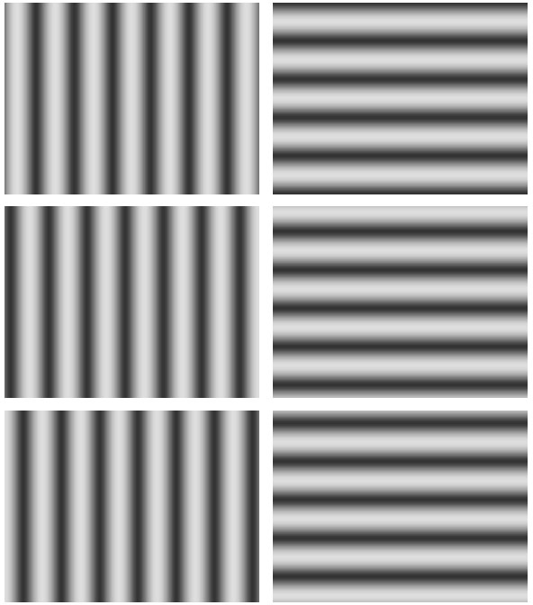

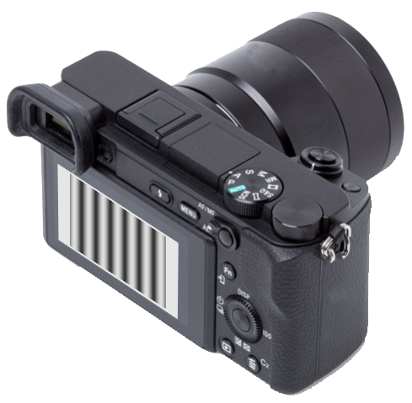
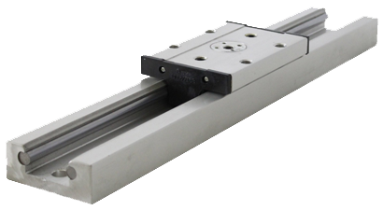
Camera Calibration
Y
Y
0
X
Z1
Z
X
3-Step
V&H Fringes
Z'
Z'
Z
Z0
ZL
LCD normal vector || Camera LoS
LCD normal vector || Axis of linear stage
Basic Calibration:
All LCD pixels are reference points.
LCD and camera are at fixed locations.
Camera faces perpendicularly to the LCD.
WCS is on the LCD (optional).
Output: Inverse Mapping Parameters.
Advanced Calibration:
All LCD pixels are reference points.
LCD moves on a linear slider to 2 or more z-locations.
Camera can be at any location.
WCS is on the LCD at z = 0.
Output: Pixel Ray Vectors and Inverse Mapping Parameters.
Notes:
LCD pixels are phase encoded by fringe patterns
Basic Calibration: LCD with Fringe Images are at fixed location, Virtual Sensor is on the LCD.
The LCD is the window that the camera views the external world.
It's also the location where the Virtual Sensor locates.
Virtual Sensor and Inverse Mapping:
1. Create a virtual sensor is to find a rectangular area (Virtual Sensor FOV) within the camera's viewing area (Sensor FOV, with distortion, non-rectangular due to lens distortion).
2. Calculate the Inverse Mapping Parameters (IMP) with the algorithm that solves the problem of "the interpolation of a point in an Arbitrary Quadrilateral".
3. Resample the original image with the IMPs to get a distortion-free image.
Advanced Calibration: Pixel Ray Vectors can be determined. Virtual Sensor can be created at any locations and orientations (6-DOF). It's not limited on the LCD plane.
Pixel Ray Vectors can fully describe the lens distortion and the relationship between Sensor and the WCS. The WCS is represented by the LCD.
The Virtual Sensor can be created at any locations and/or orientations in the WCS.
The Inverse Mapping Parameters can be determined for the Virtual Sensor.
Zhang's method can be extended to the situation when a linear stage is not available.
Line of Sight (LoS), lens optical axis.

Slide 6
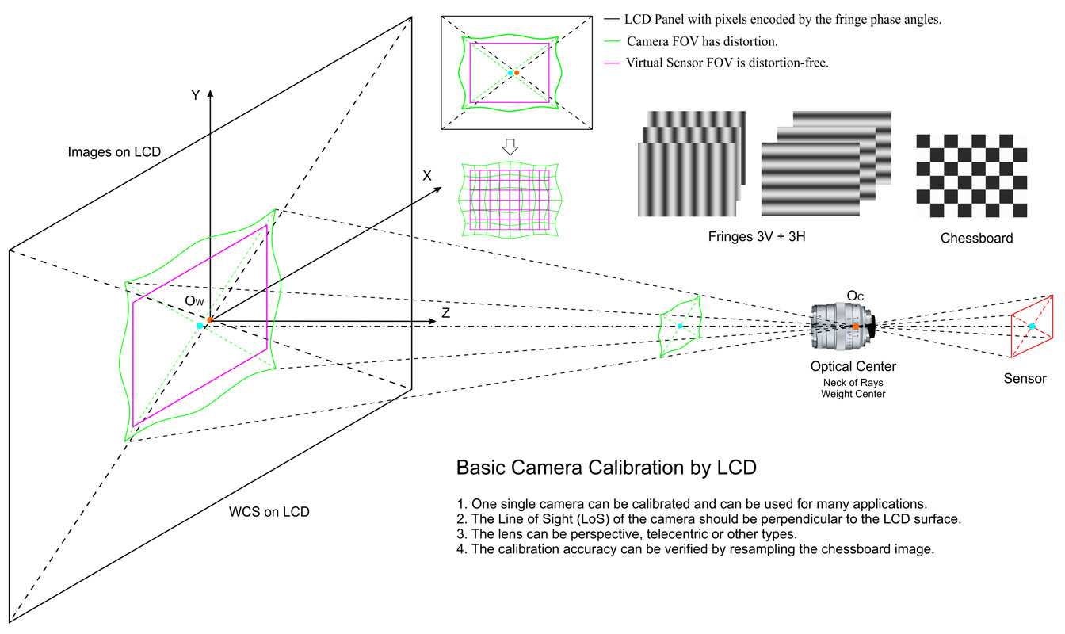
Basic Camera Calibration
Camera calibration to get the Inverse Mapping Parameters

Slide 7
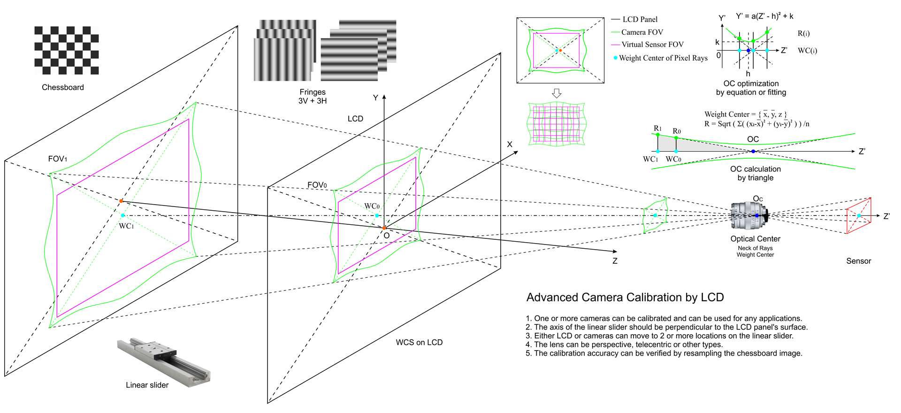
Advanced Camera Calibration
Camera calibration to get both the Pixel Rays and the Inverse Mapping Parameters
Notes:
// Formula to solve (h, k), the location of min (dSum3)
// Where x is the Z of the WCS. y is the sqrt( Sum(X^2 + Y^2) ). N is the number of rays.
//
// y = a(x-h)^2 + k
// y = ax^2 + bx + c
// x = {-1, 0, 1}
// y(i) = R(i)
// c = y2
// b = (y3-y1)/2
// a = (y3-y2)-(y3-y1)/2
// a = (y1-y2)+(y3-y1)/2
// (h, k) = (-b/(2a), -b^2/(4a) + c)

Slide 8
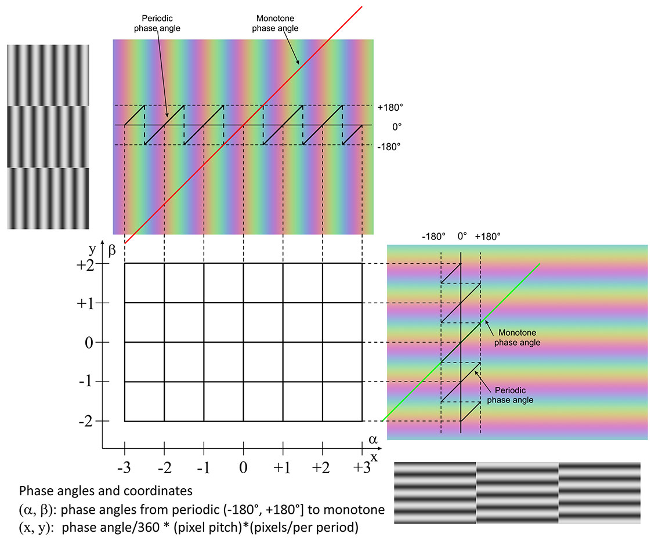
PSF and Phase Unwrapping
PSF generation
  Amplitude [>0+20, <255-25]
  Period
  Gamma
PSF displaying on LCD
  Adjust LCD lighting brightness
Image capturing
  Image range [>0+20, <255-25]
  Gamma
Image processing
  Fringe images differentiation
  Gaussian Filtering
Phase calculation
Phase unwrapping
  Periodic to monotone
Phase angle to WCS coordinates
PSF and Phase Unwrapping

Slide 9
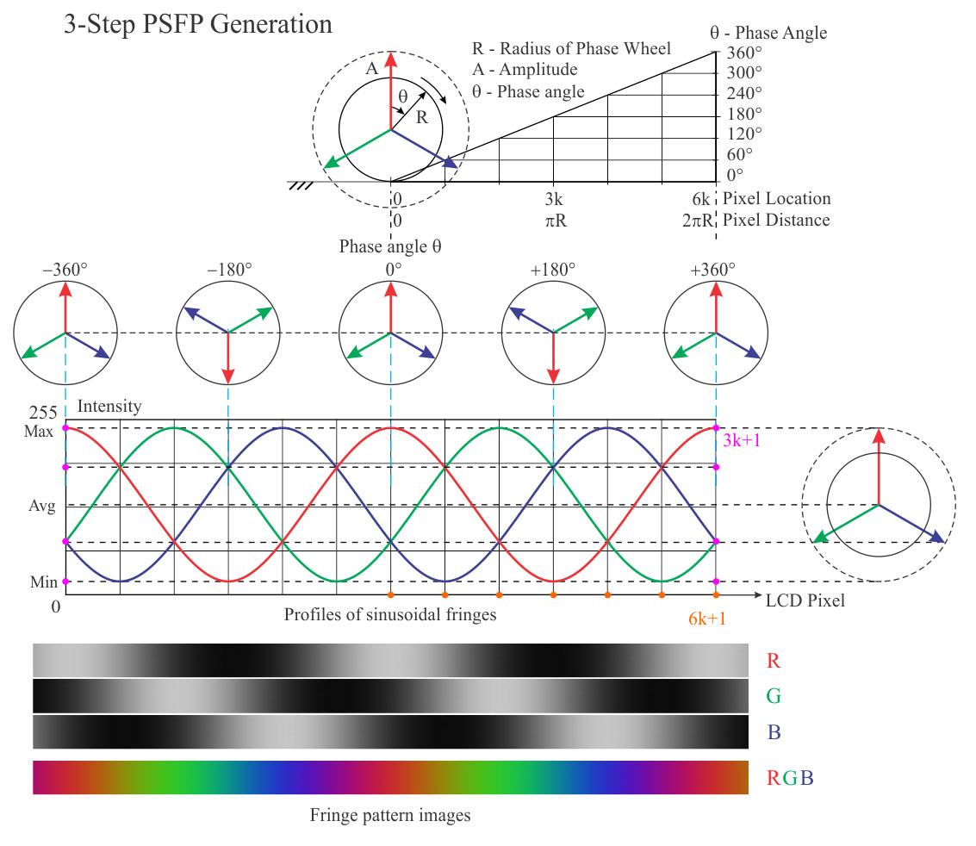
PSF with 3-Step Sinusoidal
In a period of PSF on LCD,
The number of intensities: 3k+1
The number of pixels: 6k+1
k = 1,2,3,… (Typical k = 10)
For intensity Amplitude,
0 ≤ Min < Max ≤ 255,
(Typical Max = 230, Min = 20)
Amp = (Max - Min)/2
Avg = (Min + Max)/2
3 intensities for a pixel on LCD:
I0 = R = Avg + Amp * cos(θ) (1)
I1 = G = Avg + Amp * cos(θ - 120°) (2)
I2 = B = Avg + Amp * cos(θ + 120°) (3)
One phase angle from a pixel on CMOS/CCD:
θ = atan2(sqrt(3)*(g-b), 2*r-g-b), θ∈(-180°, 180°] (4)

Slide 10
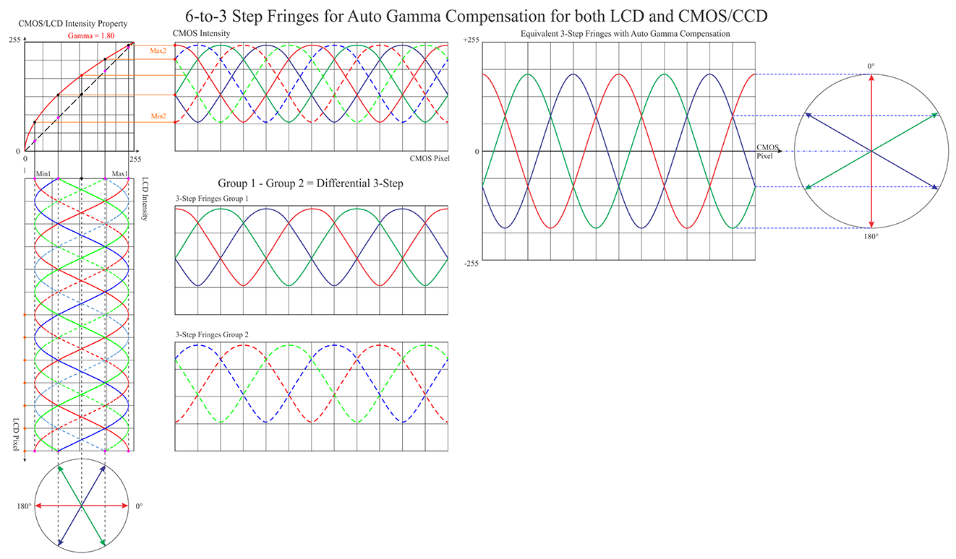
Nonlinearity Suppress
The intensity response property between CCD and LCD is nonlinear.
It causes nonlinear distribution of phase angles in space.
The nonlinearity errors can be reduced greatly by the differential 3-step PSF.
Notes:
The differential 3-step PSF can reduce phase distribution errors in space caused by the nonlinearity response if intensities between CCD and LCD.
It can make the sinusoidal frigs more pure.

Slide 11
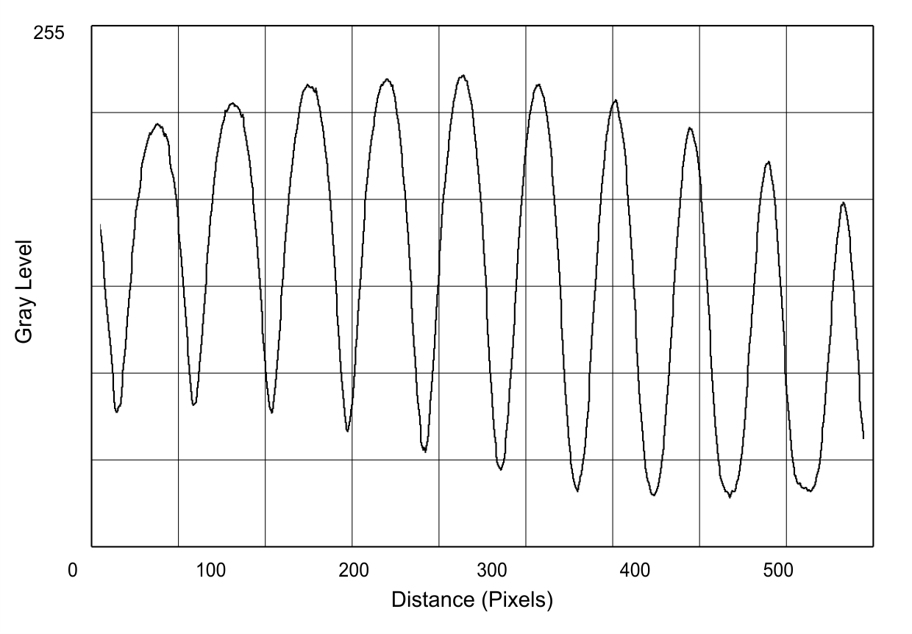
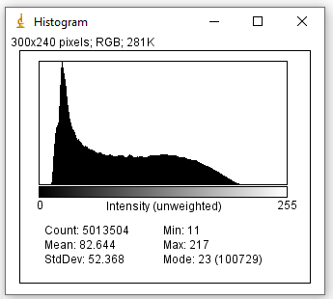
Camera Image Capturing
Profile
Histogram
Notes:
Camera Image Profile and Histogram

Slide 12
Virtual Sensors
Basic calibration
  The virtual sensor is on the LCD plane.
Advanced calibration
  The virtual sensor can be at anywhere in WCS.
3D configurations
  The virtual sensor should meet the epipolar geometry.
  The virtual pixel rows should be parallel to the baseline.
Notes:
The Virtual sensors for 3D configurations
The virtual sensor should meet the epipolar geometry.
The pixel rows (so as the sensor plane) should be parallel to the baseline.

Slide 13
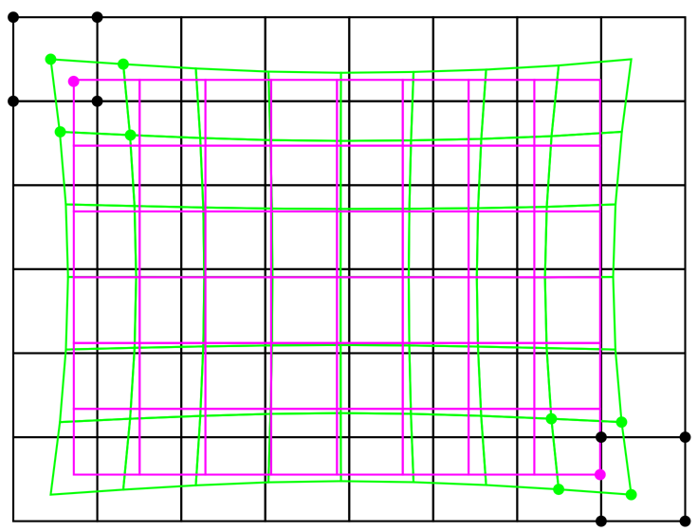
Virtual Sensor
LCD pixel
LCD plane
CCD pixel
Mapped on LCD
CCD FOV
Virtual Sensor
Pixel
Virtual Sensor FOV
Create a Virtual Sensor on LCD plane.
The virtual sensor FOV is within the CCD FOV .

Slide 14
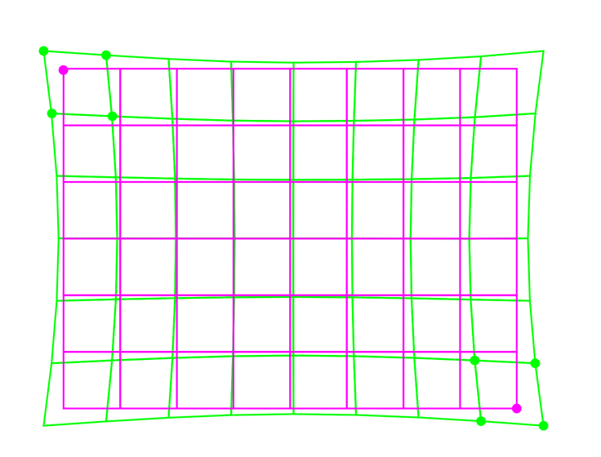
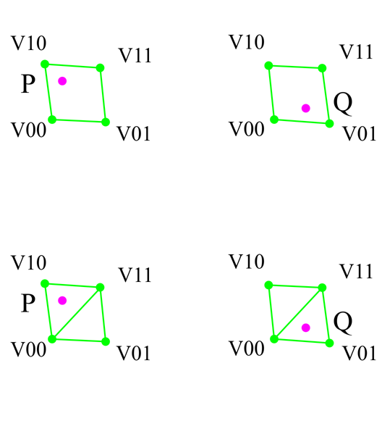
Inverse Mapping Interpolation
CCD pixel
Mapped on LCD
1. Interpolation by 4 Vertecis
Virtual Sensor
Pixel
2. Interpolation by 3 Vertecis
Inverse Mapping
Interpolation Parameter Set
Each pixel of the Virtual Sensor is inside an Arbitrary Quadrilateral of mapped CCD pixels.
The interpolation parameters can be derived from the 4-vertex or the 3-vertex.

Slide 15
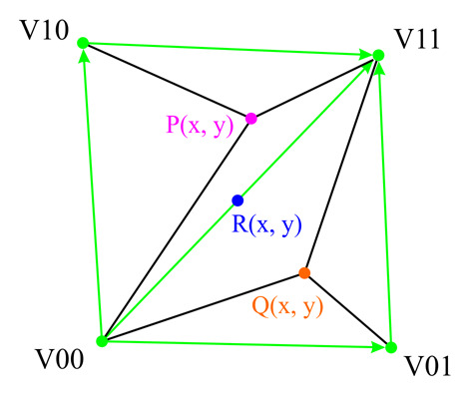
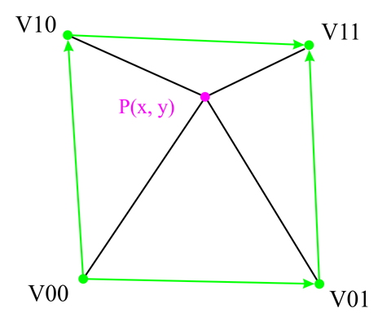
Inverse Mapping Parameters of 4-Vertex or 3-Vertex
3-Vertex algorithm
In an IMP, there are 3 pixel locations and 3 coefficients.
The IM parameters are inversely proportional to the distances to the vertices.
IMP parameters to be stored:
  V00: the location of the first pixel of the AQ.
  S - the sign shows one of the triangles of the AQ.
  The 3 coefficients.
The 3-Vertex IMP can be converted to 4-Vertex IMP.
4-Vertex algorithm
In an IMP, there are 4 pixel locations and 4 coefficients.
The IM parameters are inversely proportional to the distances to the vertices.
IMP parameters to be stored:
  V00: the location of the first pixel of the AQ.
  The 4 coefficients.
Notes:
Interpolation of a point in an Arbitrary Quadrilateral (AQ)
1. For 3-Vertex algorithm, the IMP consists of:
1.1 V00: It's the lower/left pixel location of the correspondent AQ (Arbitrary Quadrilateral) of the original image.
1.2 Sign: It shows that which of the 2 triangles is used.
1.3 The 3 coefficients.
2. For 4-Vertex algorithm, the IMP consists of:
2.1 V00: It's the lower/left pixel location of the correspondent AQ of the original image.
2.2 The 4 coefficients.

Slide 16
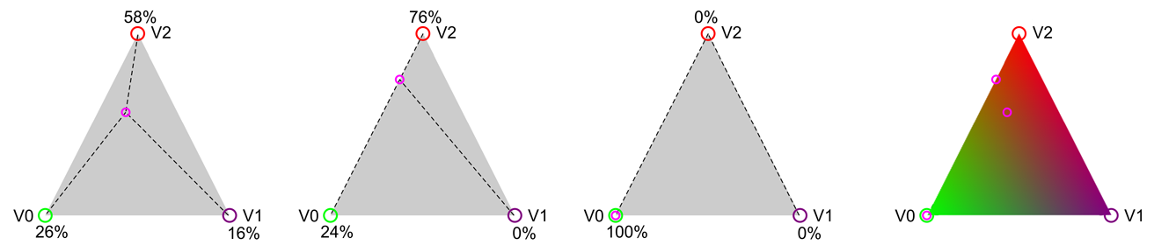
3-Vertex Triangle Interpolation
3-Vertex algorithm
In an IMP, there are 3 pixel locations and 3 coefficients.
If the point is on a line, the coefficient for the third vertex will be 0.
If the point is on a vertex, the coefficients for other 2 vertices will be 0.
The colors inside in the triangle are blended continuously.
Notes:
xy
x(1-y)
y(1-x)
(1-x)(1-y)
xy
x-xy
y-xy
1-x-y+xy
The coefficients are inversely proportional to the distances to the vertices. >> Modified to“not LINEARLY inversely proportional”

Slide 17

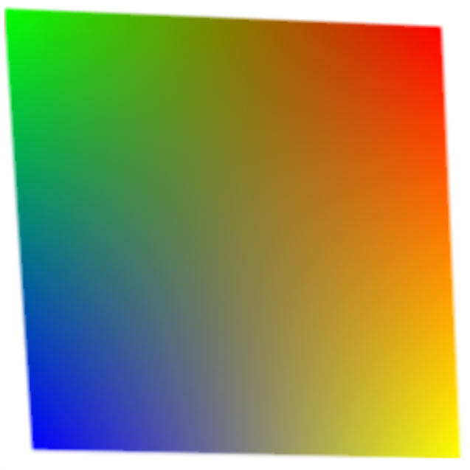
4-Vertex Interpolation
V10
V11
V10
V11
V00
V01
V00
V01
4-Vertex algorithm
In an IMP, there are 4 pixel locations and 4 coefficients.
If the point is on a line, the coefficients for the 2 vertices will be 0.
If the point is on a vertex, the coefficients for other 3 vertices will be 0.
The colors inside in the Arbitrary Quadrilateral are blended continuously.
Notes:
xy
x(1-y)
y(1-x)
(1-x)(1-y)
xy
x-xy
y-xy
1-x-y+xy
The coefficients are inversely proportional to the distances to the vertices. >> Modified to“not LINEARLY inversely proportional”
1. Arbitrary Quadrilateral:
A (V00), B (V01), C (V10), D (V11)
P(u,v) =
(1-u)(1-v)A
(u)(1-v)B
(1-u)(v)C
(u)(v)D
2. Curvilinear Arbitrary Quadrilateral:
A (V00), B (V01), C (V10), D (V11)
e(u), f(v), g(v), h(u)
P(u,v) =
-(1-u)(1-v)A
-(u)(1-v)B
-(1-u)(v)C
-(u)(v)D
+(1-v)e(u) + (v)h(u)
+(1-u)f(v) + (u)g(v)

Slide 18
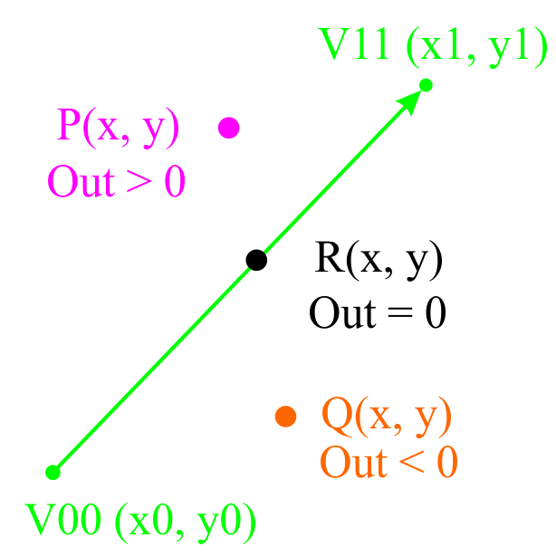
Dot vs. Vector
A dot and a vector
  A dot (x,y).
  A line or vector passes through 2 points V00 (x0, y0) and V11(x1, y1)
    The vector is toward right for horizontal lines.
    The vector is toward up for vertical lines.
Formula
  dx1 = x1 - x0;
  dy1 = y1 - y0;
  dx2 = x - x0;
  dy2 = y - y0;
  Out = dy2*dx1 - dy1*dx2;
The location of a dot relative to a vector
  Out = 0, Dot is on line ;
  Out > 0, Dot is at up or left;
  Out < 0, Dot is at down/right.
A dot vs. a vector
Notes:
// check a point (x,y) is on which side of the line from (x0, y0) to (x1, y1)
// Notice: (x0, y0) to (x1, y1) should be pointing to the up/right direction
// output: out
// 0 - dot is on the line
// +1 - dot is above the H-Line or left of the V-line
// -1 - dot is below the H-Line or right of the V-line
//
// formula:
// dx1 = x1 - x0;
// dy1 = y1 - y0;
// dx2 = x - x0;
// dy2 = y - y0;
//
// out = dy2*dx1 - dy1*dx2;

Slide 19
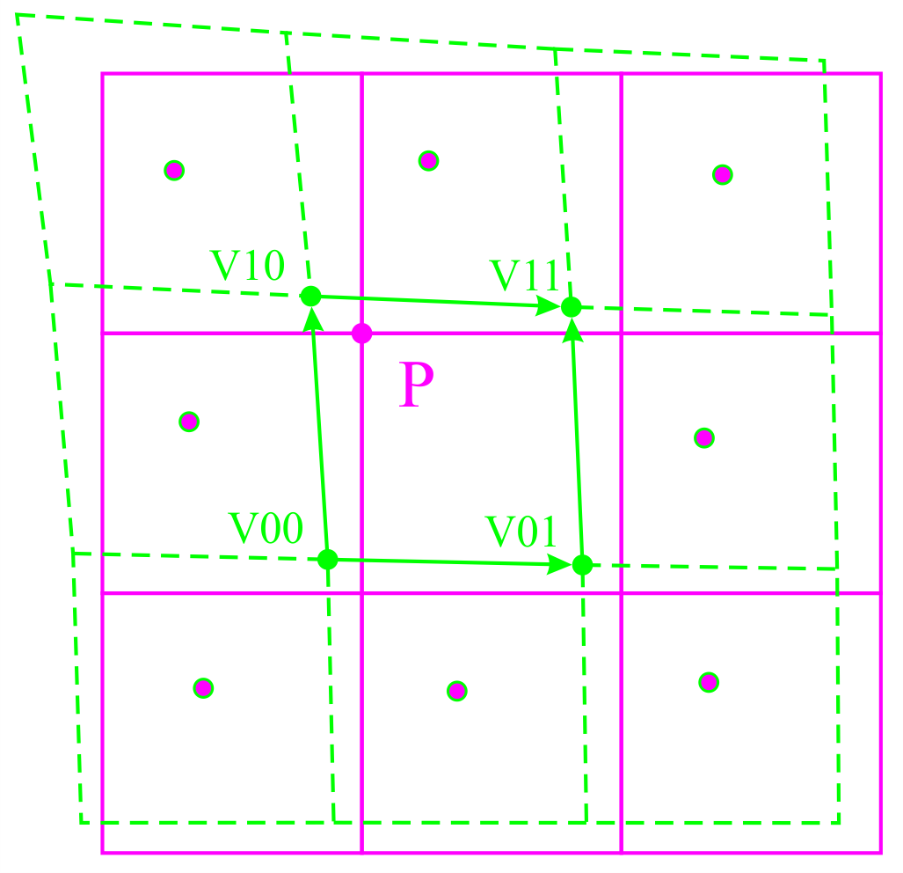
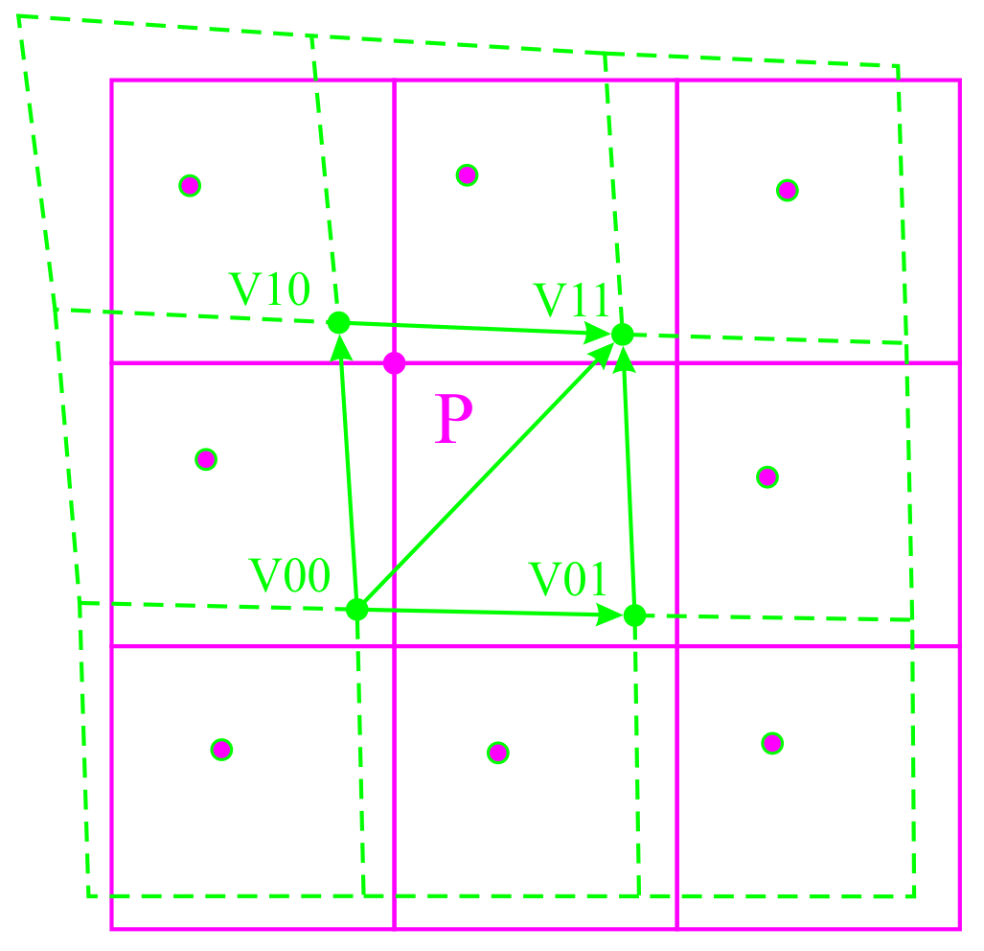
Searching Strategy and Interpolation Algorithm
CCD
Mapped
A pixel P(I, J) of the Virtual Sensor with phase angle (λ, φ) or coordinates (x, y, z), mm in WCS.
An Arbitrary Quadrilateral (AQ) of the mapped CCD.
  4 vertices: v00, v01, v10, v11 (in phase angle or mm)
  4 major vectors: v00_v01, v00_v10, v10_v11, v01_v11
  2 minor vectors: v00_v11, v01_v10
Check the location of P relative to the vectors (up to 6).
  For 4-vertex algorithm, check between P and the 4 major lines to determine if P is within the AQ. If not, change to the next AQ in the appropriate direction based on the checking results.
  For 3-vertex algorithm, check between P and one of the minor vectors.
Determine the 4 (or 3) coefficients for the Color/Intensity Interpolation algorithms.
For the next pixel P(I+1,J), start search from the current AQ.
For the first pixel of the next line P(0, J+1), search from the AQ corespondent to current line P(0, J).
Save all the coefficients as Inverse Mapping Parameter (IMP) sets.
The IMP will be used later for the image resampling to get the distortion-free images.
Virtual
Sensor
4-vertex algorithm
CCD
Mapped
Virtual
Sensor
3-vertex algorithm

Slide 20
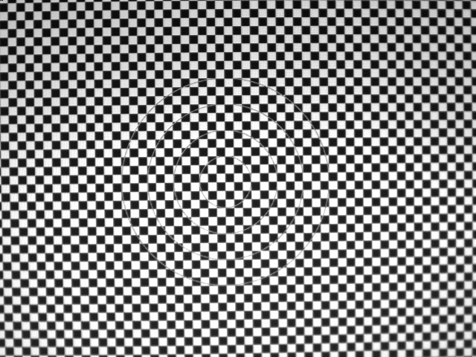
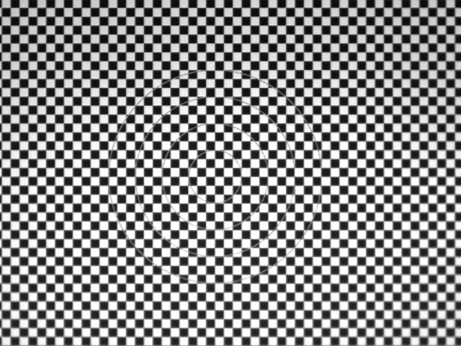
Image Rectification
Image captured
Image rectified
Notes:
A single camera with the Line of Sight faces to the LCD screen.
The Calculating Cost is the same as the normal image resampling.

Slide 21
Calibration Accuracy
Basic calibration
Capture LCD fringe images at any location.
Do the rectification.
Calculate the phase angles for all the pixels.
Fit the phase angles on a row or a column to a curve.
Analysis the error properties for all these curves.
Advanced calibration
Verify the calibration accuracy at each of the LCD locations.
Calculate the distances of each pixel to the pixel ray vectors.
Analysis the error properties.
Notes:
For images captured at a distance away from the calibration locations, the errors can be checked by an LCD at that location.

Slide 22
Setup of LCD and Cameras
LCD
  The LCD should work in Natural/Normal Mode.
  Disable any Enhancement or Smart Settings.
  The brightness of the LCD back lighting can be adjusted to make the camera exposure ideal.
  The amplitude range of the fringes should avoid high and low ends to avoid saturation or to be too dark (e.g.: [>0+20, <255-25]).
  Using digital interface (DP, HDMI, DVI, etc.) or image files in SD to avoid transfer noises if a computer is used.
  Using single color (e.g.: Green only)
Cameras
  Adjust gain and exposure time (e.g.: multiple of the physical 1/fps).
  Avoid overexposure and underexposure. ( e.g.: make image brightness range within [>0+20, <255-25] ).
  Capture images with highest bit-depth (e.g.: 16-bit)
  Using monochrome or single color (e.g.: Green only)
  Make Image Averaging if possible.
Combined adjustment of Fringes, LCD and Cameras
  The brightness of the LCD back light.
  The amplitude range of the fringes.
  The exposure time, gain of the camera.
  The Gamma of the LCD and the camera.
Notes:
Using Physical 1/fps, not interface 1/fps.
Make both Fringe and camera images be at the range of [>0+20, <255-25].

Slide 23

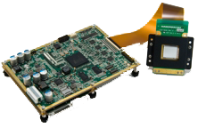
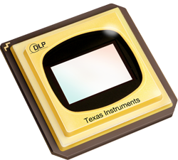
Fringe Pattern Engine - LCD & DLP
Fringe Pattern Engine as calibration references
  Flat and distortion-free
  Larger size than that of the cameras' FOV
  Even brightness and intensity adjustable
  Digital interface to computer
Flat panel LCD
  Large selection of sizes
  COTS and low cost
Spatial Light Modulator (SLM) without lens optics
  LCoS or LCD with transparent lighting
  LCoS and DMD/DLP with reflecting lighting TIR optics
LCD
SLM
DMD/DLP
Notes:
HoloEye.com for LCoS SLM
TI.com for DMD/DLP

Slide 24
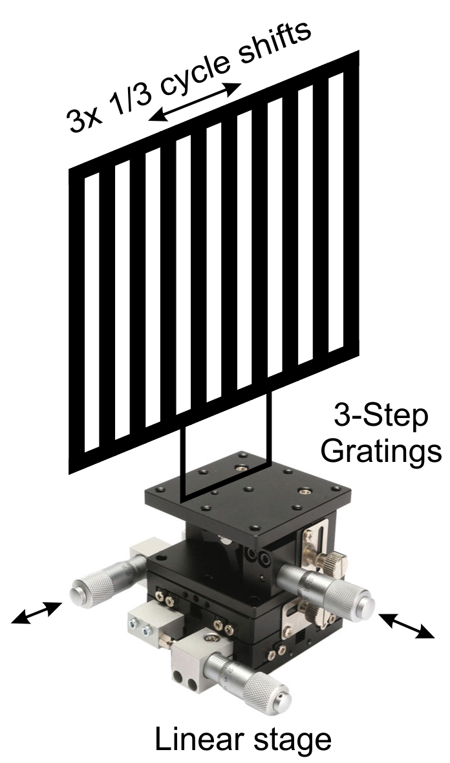
Fringe Pattern Engine - Grating
Gratings
Grids
Phantom
SLM with big dimension
  Projector in movie theater
  Galvo scanning laser
  Heated wires
SLM with extended spectrum
  EUV
  Visible
  IR
  Thermo

Slide 25
Pinhole Model vs. PRVA
Pinhole model
Calibration
  References: Limited number of Checkerboard corners.
  Pixel location error: avg > 1 pixel (non-zero and diverge).
  Output: math model with 11 (or 15, 22) distortion coefficients.
Basic Usage: For each CCD pixel, calculate the pixel ray in WCS.
Advanced usage:
  Calculate all the pixel rays in WCS.
  Create a virtual sensor.
  Calculate and save the Resampling Parameters Array (RPA).
  Resample the incoming images with the RPA.
Pixel Ray Vector Array (PRVA)
Calibration
  References: LCD pixels modulated with equal intensity phase angles.
  Pixel location error: avg=0; std=1/1,000 pixel pitch.
  Output: PRVA.
Usage:
  Create a Virtual Sensor.
  Calculate and save the Resampling Parameters Array (RPA).
  Resample the incoming images with the RPA.
Notes:
Pixel Ray Vector Array (PRVA) vs. Pinhole Model
Resampling Parameters Array (RPA):
It's for one of the virtual pixel vs. the correspondent Arbitrary Quadrilateral (AQ):
For each pixel (I, J) of the Virtual Sensor, there is a correspondent AQ. What saved in the RPA are:
The location (U, V) of the lower left vertex (pixel) of the AQ.
The 2 coefficients (u, v) for the 4 vertices of the AQ. The 4 coefficients can be derived as: (1-u)(1-v), (1-u)v, u(1-v), uv
The storage size of the RPA could be 2 uncompressed 32 bit images, i.e. 8 bytes for each virtual pixel.
All sensor pixels can be mapped from the sensor plane to a plane in WCS.
The accuracy here means the pixel location accuracy when

Slide 26
Dual-View Imaging System Calibration
The calibration can be used for any setups and applications that use 2 or more cameras
  3D scanners
  DIC systems
  Dual-view machine vision

Slide 27
Fringe Phase Fitting and Optimization
The distribution of the calculated phase angles is usually nonlinear and periodic.
  Gamma curves of the LCD and the sensors.
  Moire patterns.
Fringe phase mapping, interpolation, fitting and optimization
  The phase angles at the multiple of 120° are least affected.
  The pixel locations of nx 120° can be retrieved by Arbitrary Quadrilateral Interpolate (AQI) algorithm.
  The property curves of nx120° phase angles vs. pixel locations can be fitted and optimized with polynomial functions.
  By the above polynomial functions, the phase angles in between and out of the nx120° can be interpolated, extrapolated and fitted alternately.
  The optimized map of pixel locations vs. phase angles can be retrieved by AQI algorithm.

Slide 28
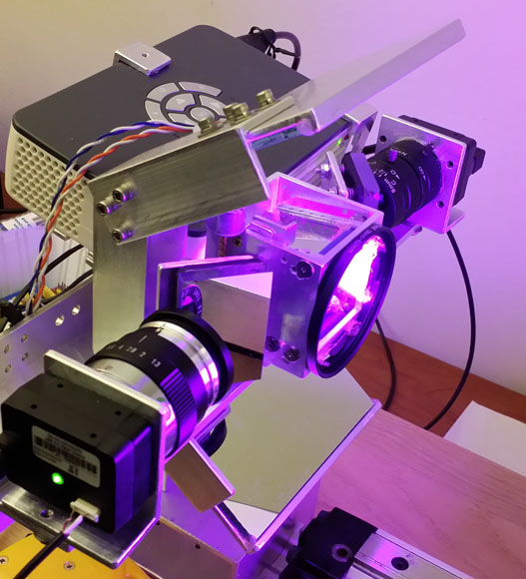
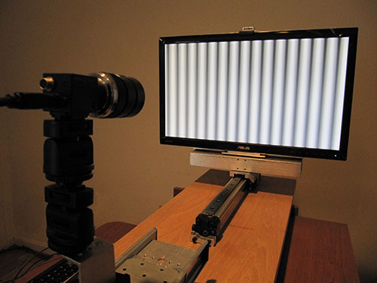
Calibration Stage with LCD Flat Panel
3D Scanner with shift/tilt lens
Calibration station with LCD panel on linear slider
Notes:
3D scanner with multi-spectrum, multi-path, phase shifting structure lighting and shift/tilt lens for objects with specular surfaces and partially transparent surfaces.

Slide 29
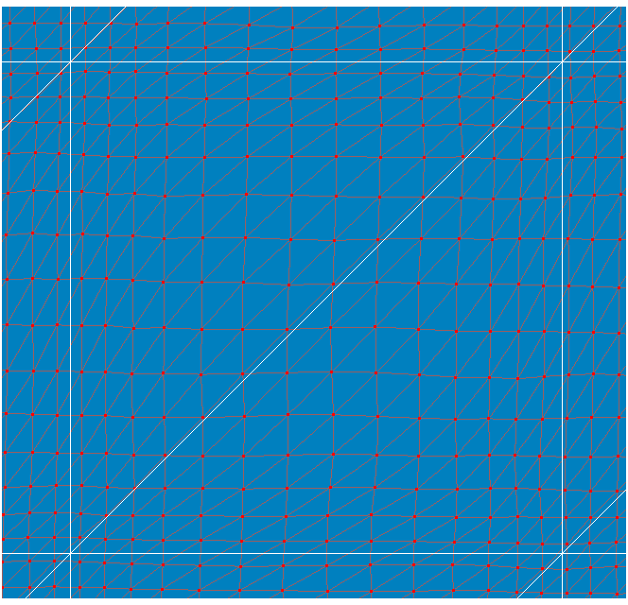
Distribution Properties of Pixel-Phase Map
The Pixel-Phase map distribution.
  Nonlinear
  Periodic
The nx120° phases are least affected.
Optimization of Pixel-Phase and Phase-Pixel maps.
  AQI (Arbitrary Quadrilateral Interpolation)
  Polynomial fitting, interpolation and extrapolation
Pixel-Phase Map
Red: full resolution, phase angles at integer pixels
White: nx120° phase angles at interpolated pixels
Notes:
Find all the pixel locations at 120° phase angles within the FOV by AQI interpolation.
Arbitrary Quadrilateral Interpolation.

Slide 30
Optimize the Pixel-Phase Distribution
AQI for 120° Phase
Polynomial Fitting
Uneven
Pixel-Phase
Distribution
Pixel-Phase
120° Phase-Pixel
120° Phase-Pixel
(I, J) - (u, v)
(U120, V120) - (i, j) (Original)
(U120, V120) - (i, j)
(Optimized by fitting)
AQI for Integer Pixel
Progressive polynomial
fitting and interpolation
Even
Pixel-Phase
Distribution
Pixel-Phase
Phase-Pixel
(I, J) - (u, v)
(U, V) - (i, j)
*AQI - Arbitrary Quadrilateral Interpolation
(I, J) - Integer pixel
(i, j) - Decimal pixel
(u, v) - Decimal phase
(U, V) - Integer phase
(U120, V120) - 120° phase
Notes:
-Moire algorithm
The 120° Phase-Pixel array can be extended by extrapolation. It can cover more area than the original FOV

Slide 31
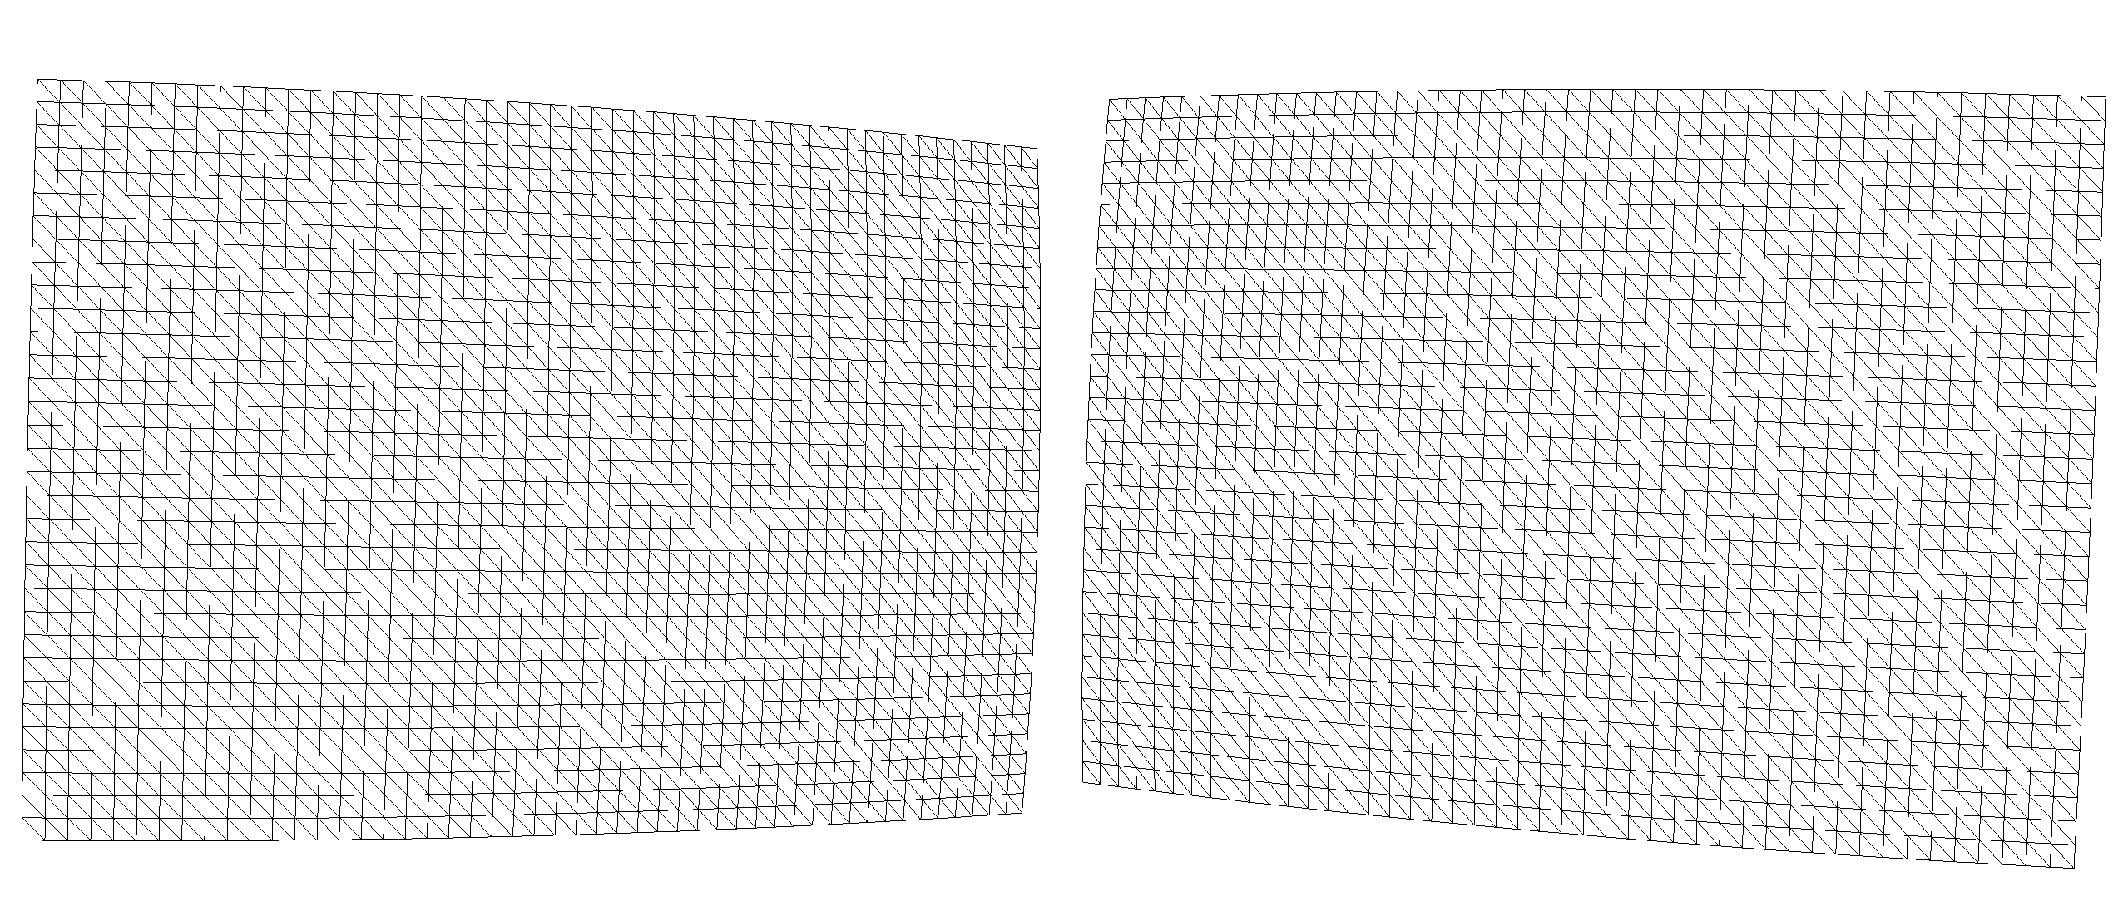
Retrieved and Fitted 120° Pixel Map
The 120° Phase Map distributes evenly across the whole FOV
Fitting and interpolation can optimize the distribution

Slide 32
Optical Center
Approach 1: Minimum distances between the OC and the Ray Vectors
  Ray vectors can be got from the pixel coordinates (x,y, Z) at 2 Z-locations (direct calculation) or more Z-locations (fitting)
  Fitting to get the Optical Center by minimize the distances from it to the set of ray vectors.
Approach 2: Weight Center and the Moment of Inertia
  The pixel locations (x,y, Z) are proportional to the phase angles (U, V, Z) at each Z-locations of LCD on the linear slider.
  The Weight Center and the Moment of Inertia at each z-Locations can be calculated from these pixels.
  The Optical Center can be got from 2 Weight Centers and the Moment of Inertia.
  The OC location can be further optimized by mapping the Ray Vectors to 3 or more locations near the above OC and find the neck location as the new OC.
The compensation of LCD panel optical properties
  The refractive index and the thickness of the LCD screen panel
  The spectrum of the LCD backlight

Slide 33
Virtual Sensor
Virtual Plane
  The Virtual Plane must be parallel to the Baseline Vector.
  The location should be put near the work center.
  A Virtual Sensor Coordinate System can be created.
Virtual Sensor
  Map the Pixel Ray Vectors to the virtual plane to get the FOV.
  Create the Common Virtual Sensors within the Common FOV.
    The pixel resolution and the aspect ratio can be the same as the physical sensors.
  Configure the virtual pixel ray vector arrays
    For the pinhole model, the optical center is the common location for all the virtual pixel ray vectors of a camera.

Slide 34
Inverse Mapping Parameter (IMP)
The 2 IMPs are for the rectification resampling from the original images to the distortion-free images on the Common Virtual Sensor.
The 2 IMPs can be calculated with the Arbitrary Quadrilateral Interpolation (AQI) algorithm.
  IMPs can be stored on external storage.
  IMPs can be built-in.
  IMPs can be described by polynomial functions or NURBS.

Slide 35
Pixel Matching and 3D Reconstruction
With Optical Centers
  The virtual sensors meet the requirements of the Epipolar principal.
  Pixel matching is between the pixels within the same line.
Backward compatible with pinhole model
  The pinhole camera math model can be constructed by setting all the distortion coefficients to 0.
Without Optical Centers
  Triangulation with local vectors.

Slide 36
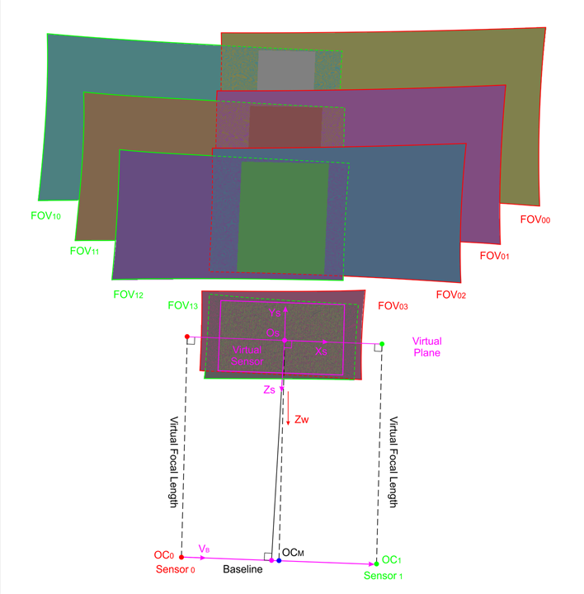
Dual-View Camera Calibration
Capture fringe encoded Images
Calculate fringe phase maps
Convert to coordinate maps
Fit optical centers
Create virtual plane
Map pixel rays to virtual plane
Create common virtual sensor
Calculate IMPs
LCD panel at 2 or more z-locations on linear stage
Notes:
Optical Centers:
-68.463867 -3.295898 +234.204102
+65.478516 -7.729492 +236.505859
Baseline Vector:
+0.999305 -0.033078 +0.017173
Virtual Plane location and directions:
-1.492676 -5.512695 +0.000000
+0.999305 -0.033078 +0.017173
+0.033083 +0.999453 -0.000000
-0.017163 +0.000568 +0.999853
Optical Centers on Virtual Plane:
-64.424984 -3.429589 -1.081472
+69.517399 -7.863182 +1.220286
Virtual focal length:
+235.320274
LCD panel at z-locations: 3
Pos ( Xi, Yi, Zi ); uV ( uVx, uVy, uVz ) (mean std ) Points
+2.116393 -1.297198 -228.581433 +0.000633 -0.000021 +1.000000 -0.000061 +0.000593 69600
+1.789067 -1.760847 -177.800010 +0.000000 +0.000000 +1.000000 +0.000013 +0.000023 99840
+1.291300 -2.218927 -127.013760 -0.000468 +0.000016 +1.000000 +0.000053 +0.000899 137760
Phase Map, Optical Center and Virtual Sensor
Optical Centers:
-68.463867 -3.295898 +234.204102
+65.478516 -7.729492 +236.505859
Baseline Vector:
+0.999305 -0.033078 +0.017173
Virtual Plane location and directions:
-1.492676 -5.512695 +0.000000
+0.999305 -0.033078 +0.017173
+0.033083 +0.999453 -0.000000
-0.017163 +0.000568 +0.999853
Optical Centers on Virtual Plane:
-64.424984 -3.429589 -1.081472
+69.517399 -7.863182 +1.220286
Virtual focal length:
+235.320274
LCD panel at z-locations: 3
Pos ( Xi, Yi, Zi ); uV ( uVx, uVy, uVz ) (mean std ) Points
+2.116393 -1.297198 -228.581433 +0.000633 -0.000021 +1.000000 -0.000061 +0.000593 69600
+1.789067 -1.760847 -177.800010 +0.000000 +0.000000 +1.000000 +0.000013 +0.000023 99840
+1.291300 -2.218927 -127.013760 -0.000468 +0.000016 +1.000000 +0.000053 +0.000899 137760

Slide 37
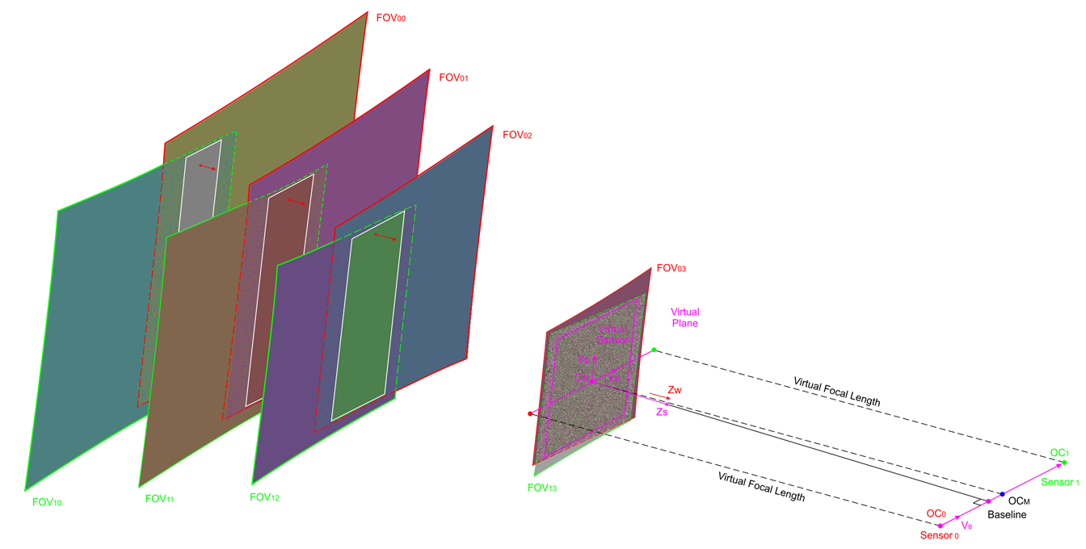
Image Rectification, Pixel Matching and 3D Reconstruction
Capture fringe encoded images
  Images with distortion
Rectify images with IMPs
  Distortion-free images
Calculation phase angles
  Phase maps
Pixel phase matching
  An integer pixel of one virtual sensor
  A decimal pixel interpolated from 2 pixels of other virtual sensor
  2 vectors in space
Triangulation
  The cross point of 2 space vectors
LCD panel with fringes
Planar panel illuminated by projector fringes
Panel at 1 or more z-locations on linear stage
Notes:
Configure the Virtual Plane:
1. Map the middle point of 2 optical centers to z=0 plane and make it as the coordinate Os (0, 0, 0) of the Virtual Sensor. i.e.: { (x0+x1)/2, (y0+y1)/2, 0 }.
2. Make Xs axis be parallel to the Baseline Vector.
3. Projecting the Os to the Base line, connecting the 2 points and make it as Zs axis.
4. Cross product to get the Ys axis.
Options of select the Common FOV on Virtual Plane:
1. at the middle of the working Depth of Field
2. have maximum Common FOV
Parameters to be saved for Image Rectification and 3D Reconstruction:
1. Two IMPs
2. Two Optical Centers (for pinhole cameras); or Two Unit Vector Arrays (for non-pinhole cameras).
3. Three unit vectors of the Virtual Plane and the Virtual Sensor.
4. The parameters of the Common Virtual Sensor: the locations of the 4 corner points; the resolution of the sensor, etc.

Slide 38
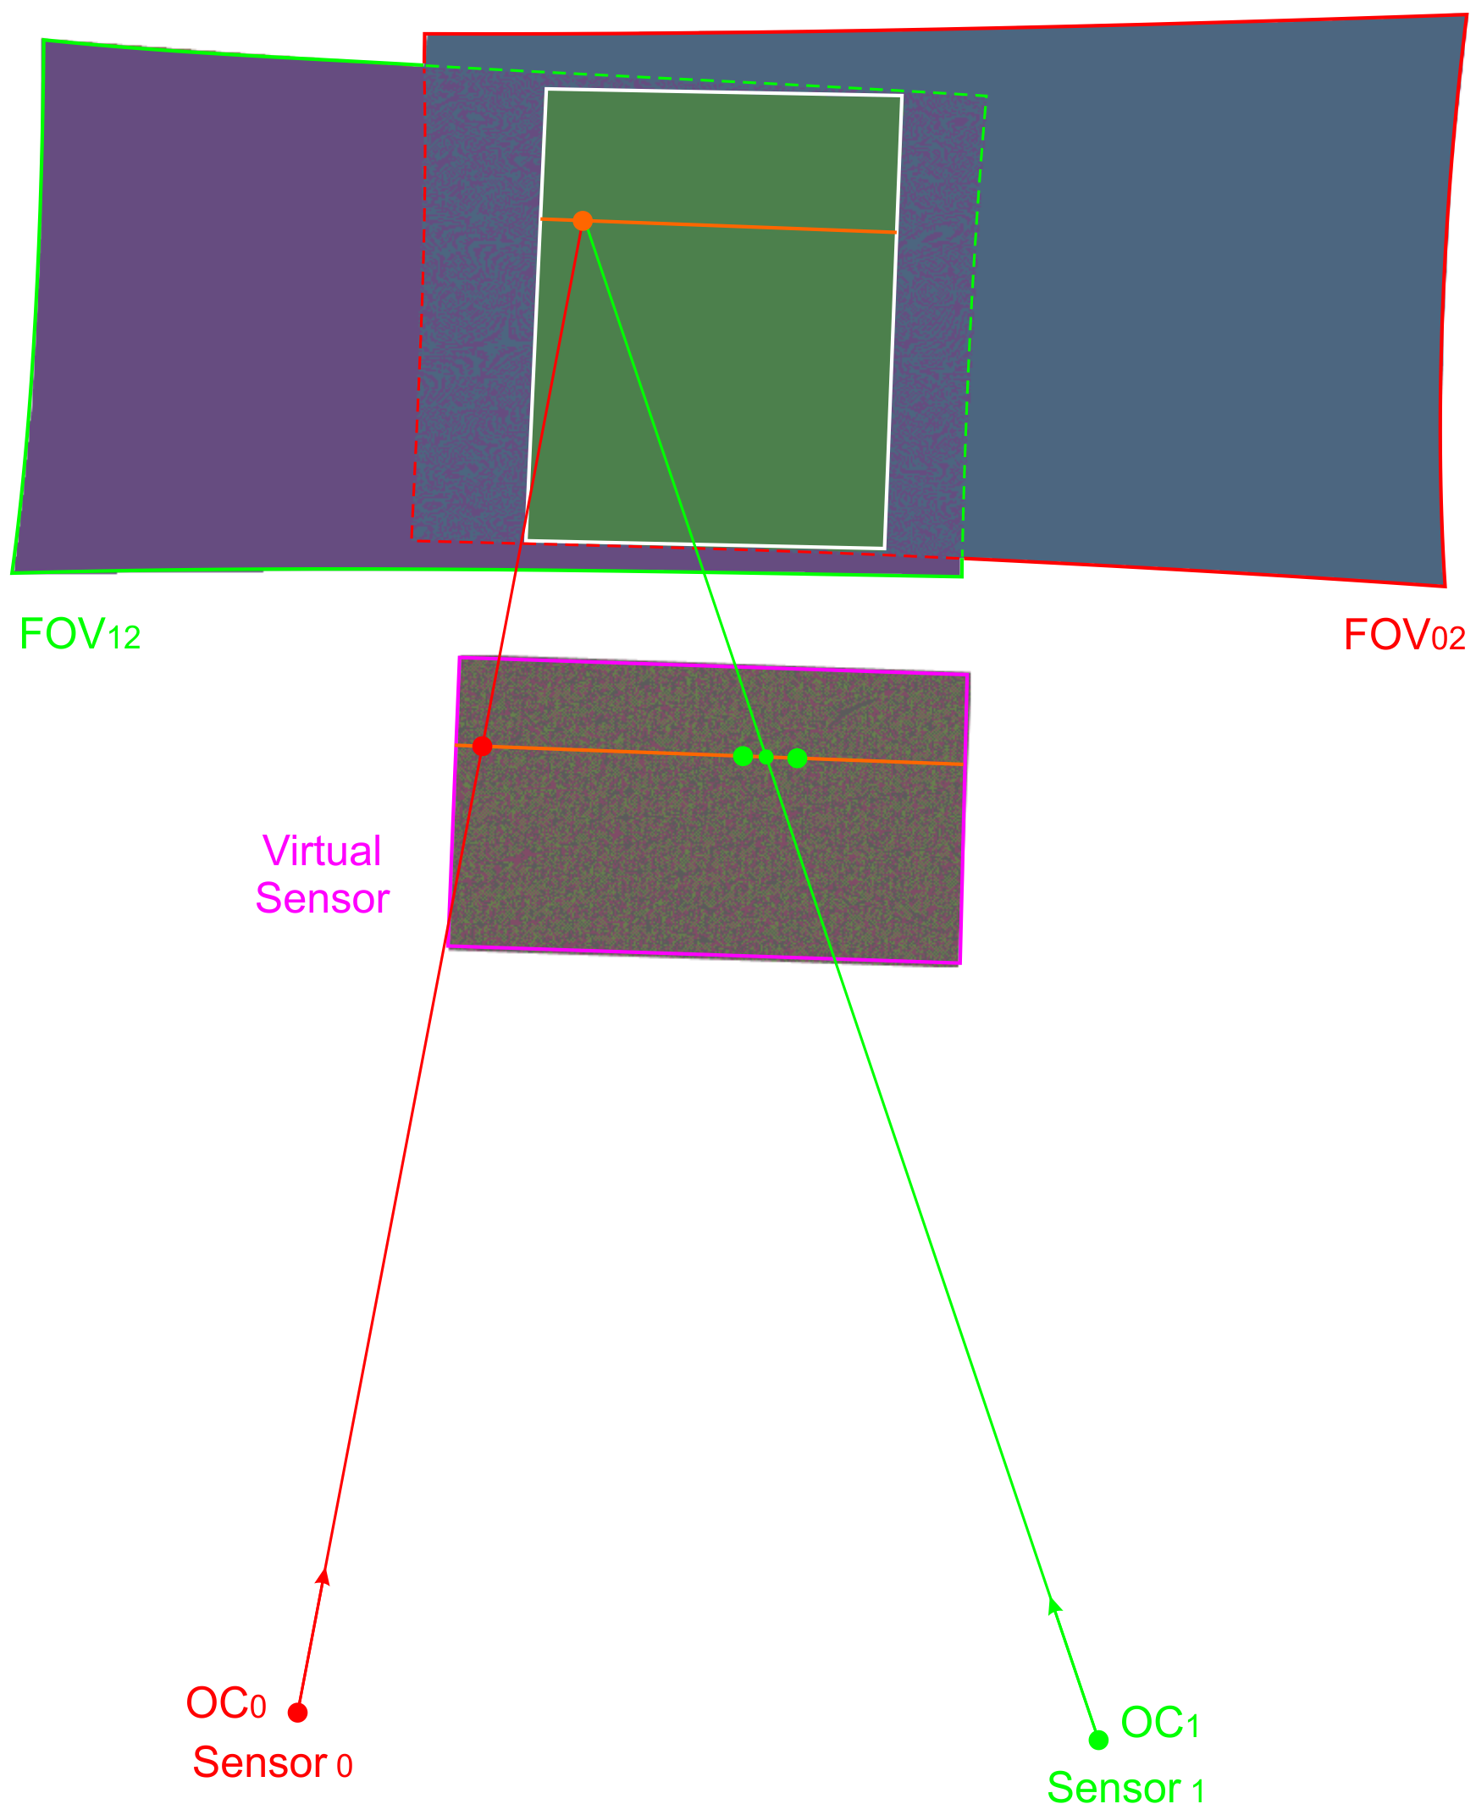
3D Reconstruction Algorithm
Image capture
  Images with distortion
Image rectification
  Distortion-free images
Phase angle calculation
  Phase map
Pixel matching
  One integer pixel
  One interpolated pixel
Triangulation
  The cross point of 2 space vectors
Triangulation by 2 space vectors

Slide 39
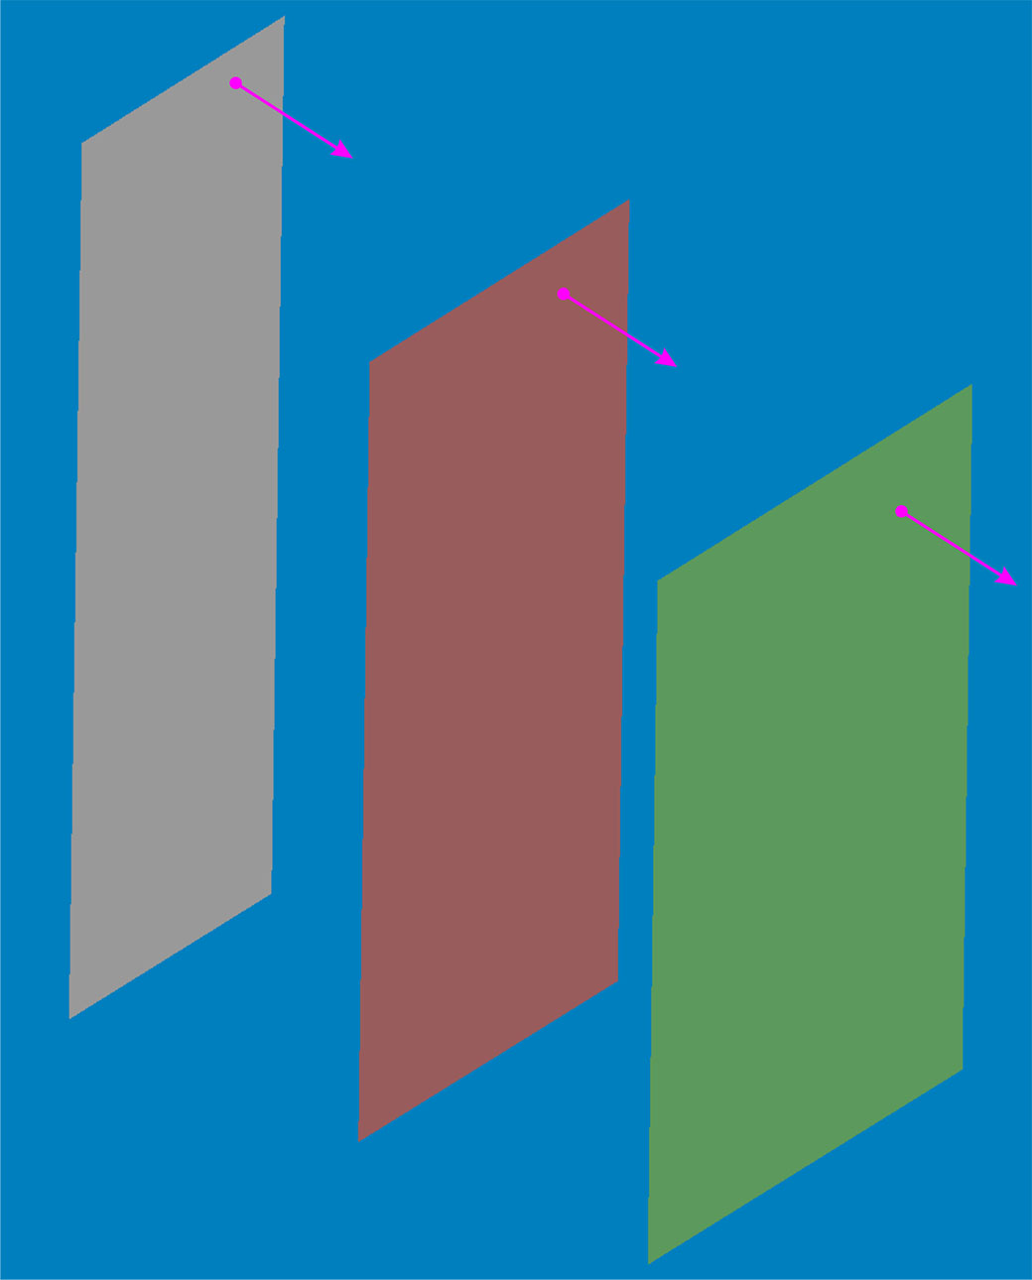
Error Analysis
3D reconstruction of planar surfaces
  LCD panel with fringe images
  Planar panel illuminated by projector fringes
  The planar surfaces at 1 or more z-locations
3D point cloud errors
  Do 3D reconstruction to get the point cloud
  Fit the point cloud to a plane
  The errors are the distances of the points to the fitted plane
2D image distortion errors
  LCD flat panel as reference
  Capture fringed images displayed by LCD
  Do the image rectification
  Calculate the phase map
  Fit the phases line-by-line to straight lines
  The errors are the distances to the lines
Fit the point cloud to planes
Plane Locations ( Xi, Yi, Zi ); Plane unit vectors ( uVx, uVy, uVz ); Errors (mean , std ) (mm); Points
+2.116393, -1.297198, -228.581433; +0.000633, -0.000021, +1.000000; -0.000061, +0.000593; 69600
+1.789067, -1.760847, -177.800010; +0.000000, +0.000000, +1.000000; +0.000013, +0.000023; 99840
+1.291300, -2.218927, -127.013760; -0.000468 , +0.000016, +1.000000; +0.000053, +0.000899; 137760
Notes:
LCD panel at z-locations: 3
Positions ( Xi, Yi, Zi ); Plane unit vectors ( uVx, uVy, uVz ); Errors (mean , std ); Points
+2.116393, -1.297198, -228.581433; +0.000633, -0.000021, +1.000000; -0.000061, +0.000593; 69600
+1.789067, -1.760847, -177.800010; +0.000000, +0.000000, +1.000000; +0.000013, +0.000023; 99840
+1.291300, -2.218927, -127.013760; -0.000468 , +0.000016, +1.000000; +0.000053, +0.000899; 137760

Slide 40
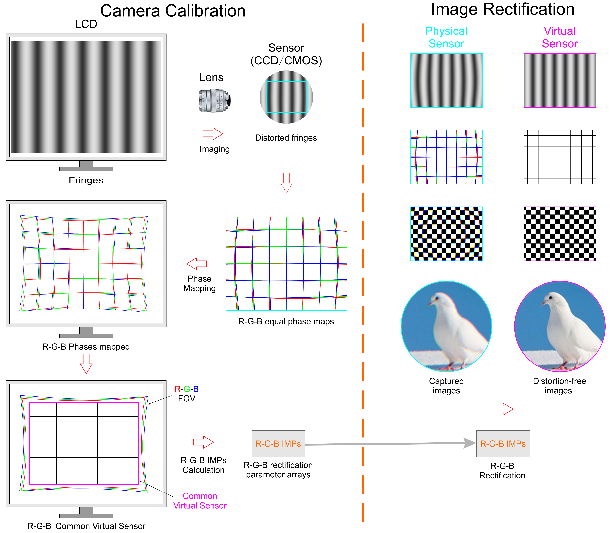
Calibration of Chromatic Aberration
Calibration
LCD displays gray fringes.
Color camera captured images have chromatic aberration.
Calculate phase angles of R,G,B channels independently.
Configure a common Virtual Sensor for the 3-channels.
Calculate 3 IMPs for the 3-channel.
Rectification
Rectify the 3-channels independently.
Combine the 3-channels to get a color image.
Notes:
1. LCD panel for calibration:
1.1 Monochrome LCD panel: All the gray pixels can be used for the chromatic calibration directly.
1.2 Color LCD panel: R,G,B channel pixels may distribute interleaved in some patterns. The structure should be known.
1.3 Pixel level phase shift fringes may be used to make the combined fringes smoother.
1.4 Pixel distribution: Strip distribution, RGBG, RGBW, triangular distribution, mosaic distribution, square distribution, etc.
2. Foveon X3 sensor vs. Bayer sensor:
2.1 Foveon X3 sensor cameras can be calibrated directly.
2.2 Bayer sensor cameras should be calibrated upon the Bayer images.
Monochromatic aberrations
The most common monochromatic aberrations are:
Defocus
Spherical aberration
Coma
Astigmatism
Field curvature
Image distortion
Chromatic aberrations
Chromatic aberration occurs when different wavelengths are not focused to the same point. Types of chromatic aberration are:
Axial (or "longitudinal") chromatic aberration
Lateral (or "transverse") chromatic aberration
Reduce chromatic aberration by using ED glass lens.

Slide 41
Applications
Camera calibration
  2D cameras.
  3D stereo cameras.
  Special lenses.
  Any complex combination of optical structures.
Projector calibration
  Projector.
  Short throw TV.
Optical components
  Parameter verification.
  Defects inspection.

Slide 42
​Application Samples
Suitable for any cameras with optical structures with or without math models:
  Pinhole lens, Telecentric lens, Hypercentric lens and Pericentric lense, Fisheye lens, Omni-directional lens, etc.
Suitable for all 2D and 3D cameras.
Suitable for static images and realtime videos.
Fully backward compatible with pinhole models and the applications.
Get sharp clear multiple spectrum (from UV to thermal) images with 0 chromatic aberration.
MTF analysis with 1/1,000 pixel level details and accuracy automatically.
Close loop optical components design, manufacturing and verification.
The same principle works for all imaging systems
  Image sensing
  Image projection
The calibrated camera can be used to calibrate other displaying or illumination devices to achieve highest accuracy:
  Projectors, Projecting TV, MEMS mirrors, laser galvos, FSM, etc.
Notes:
Examples of applications:
1. Projector calibration. Shot throw projectors.
2. Ray tracing verification. Can be used to verify the design and manufacturing of lens optics for close-loop design and manufacturing.
3. Angle measurement. Measure the distance between 2 remote objects by Smart Digital Binoculars, Laser Rangefinders, Vectronix VECTOR 23 Rangefinding Binocular.
4. High rotating speed (up to 24,000 RPM) 3D DIC or 3D scanner with split lens (1 right angle prism and 2 pentaprism).
5. Measurement and monitoring of dam shift.
6. DJI drone with Phase One cameras.
7. Optic exposures for circuit boards or prepress printing .
8. Calibration of Long Wave IR camera or thermal camera. Fringe image generation by moving thin wires that the current or heat can be adjusted.
9. Tunable hyperchromatic lenses.
10. Seamless stitching of 2D image.
11. Seamless stitching of 3D point cloud.
Vector 23 Rangefinder Binocular, $25k:
Angular FOV: 120mil / 6.75° (1mil = 0.06°, 16.66mil = 1°)
Angular accuracy: ± 5 mil / ± 0.3°
If: Camera linear resolution: 2,000 pixel
120mil/2,000 (pixel)/1,000 (std) = 60mil/1million

Slide 43
3D Scanners and 3D DIC
Calibrate the Stereo Camera Pair
  Put the LCD or the camera pairs on a linear stage.
  Display and capture fringe images at 2 or more z-locations.
  Calculate the phase angles and fit the Pixel Ray Vectors.
  Calculate and fit the Optical Centers of the cameras.
Create virtual sensors and calculate the IMP
  Create a common virtual sensor plane.
  Map the Pixel Rays to the plane.
  Create a Common Virtual Sensor.
  Calculate the Inverse Mapping Parameter sets for the 2 cameras.
Image rectification
  Rectify the captured images with the IMPs.
References for pixel matching or pixel subset correlation
  For 3D scanner: Structured lighting.
  For 3D DIC: Speckle patterns.
Special optical structures
  Shift/tilt lens cameras.
  Split lens camera.
Notes:
The Common Virtual Sensor meets the requirements of Epipolar Geometry.

Slide 44
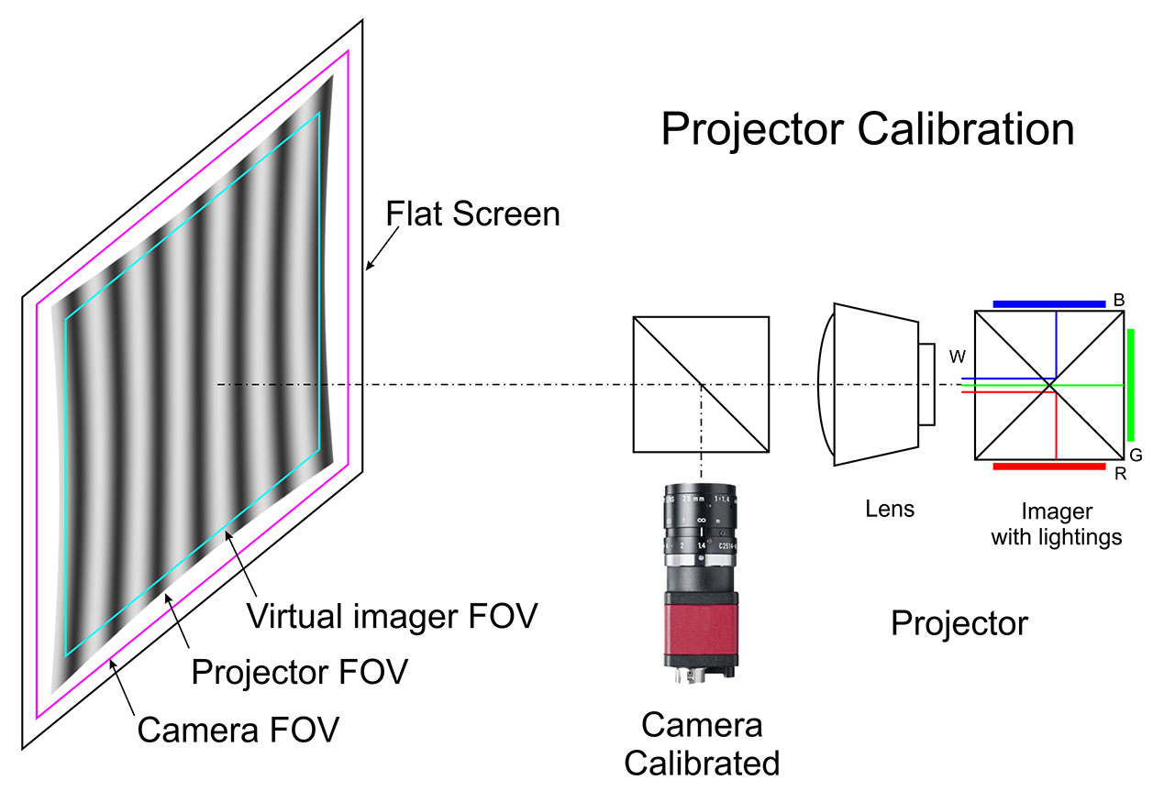
Projector Calibration
Imager calibration
  Project fringes on a flat screen with an imager.
  Capture images by a calibrated camera.
  The pixel ray locations on the screen can be determined by the camera.
  The 3 imagers can be calibrated independently.
Virtual Imager and 2-Stage Mapping
  Create a common Virtual Imager on the screen.
  Calculate the 1st-stage Mapping Parameters for each Virtual Imager Pixel.
  Calculate the 2nd-stage Mapping Parameters for each Physical Imager Pixel.
Image resampling and projection
  Resample the image to be projected using the 1st MP.
  Resample the distortion-free image back to the imager using the 2nd-MP.
  Project the twice resampled image.
  Blended image colors should match correctly on screen.
  Pixel locations may not match physically.
Notes:
1st-stage Mapping: interpolation of a point in an Arbitrary Quadrilateral (AQ) .
2nd-stage Mapping: interpolation of a point in a Square.
Applications:
Prepress, industry printing.
3D printing with light sensitive liquid.
PCB exposure.
It can also calibrate Galvos, FSM, MEMS laser scanner, etc.

Slide 45
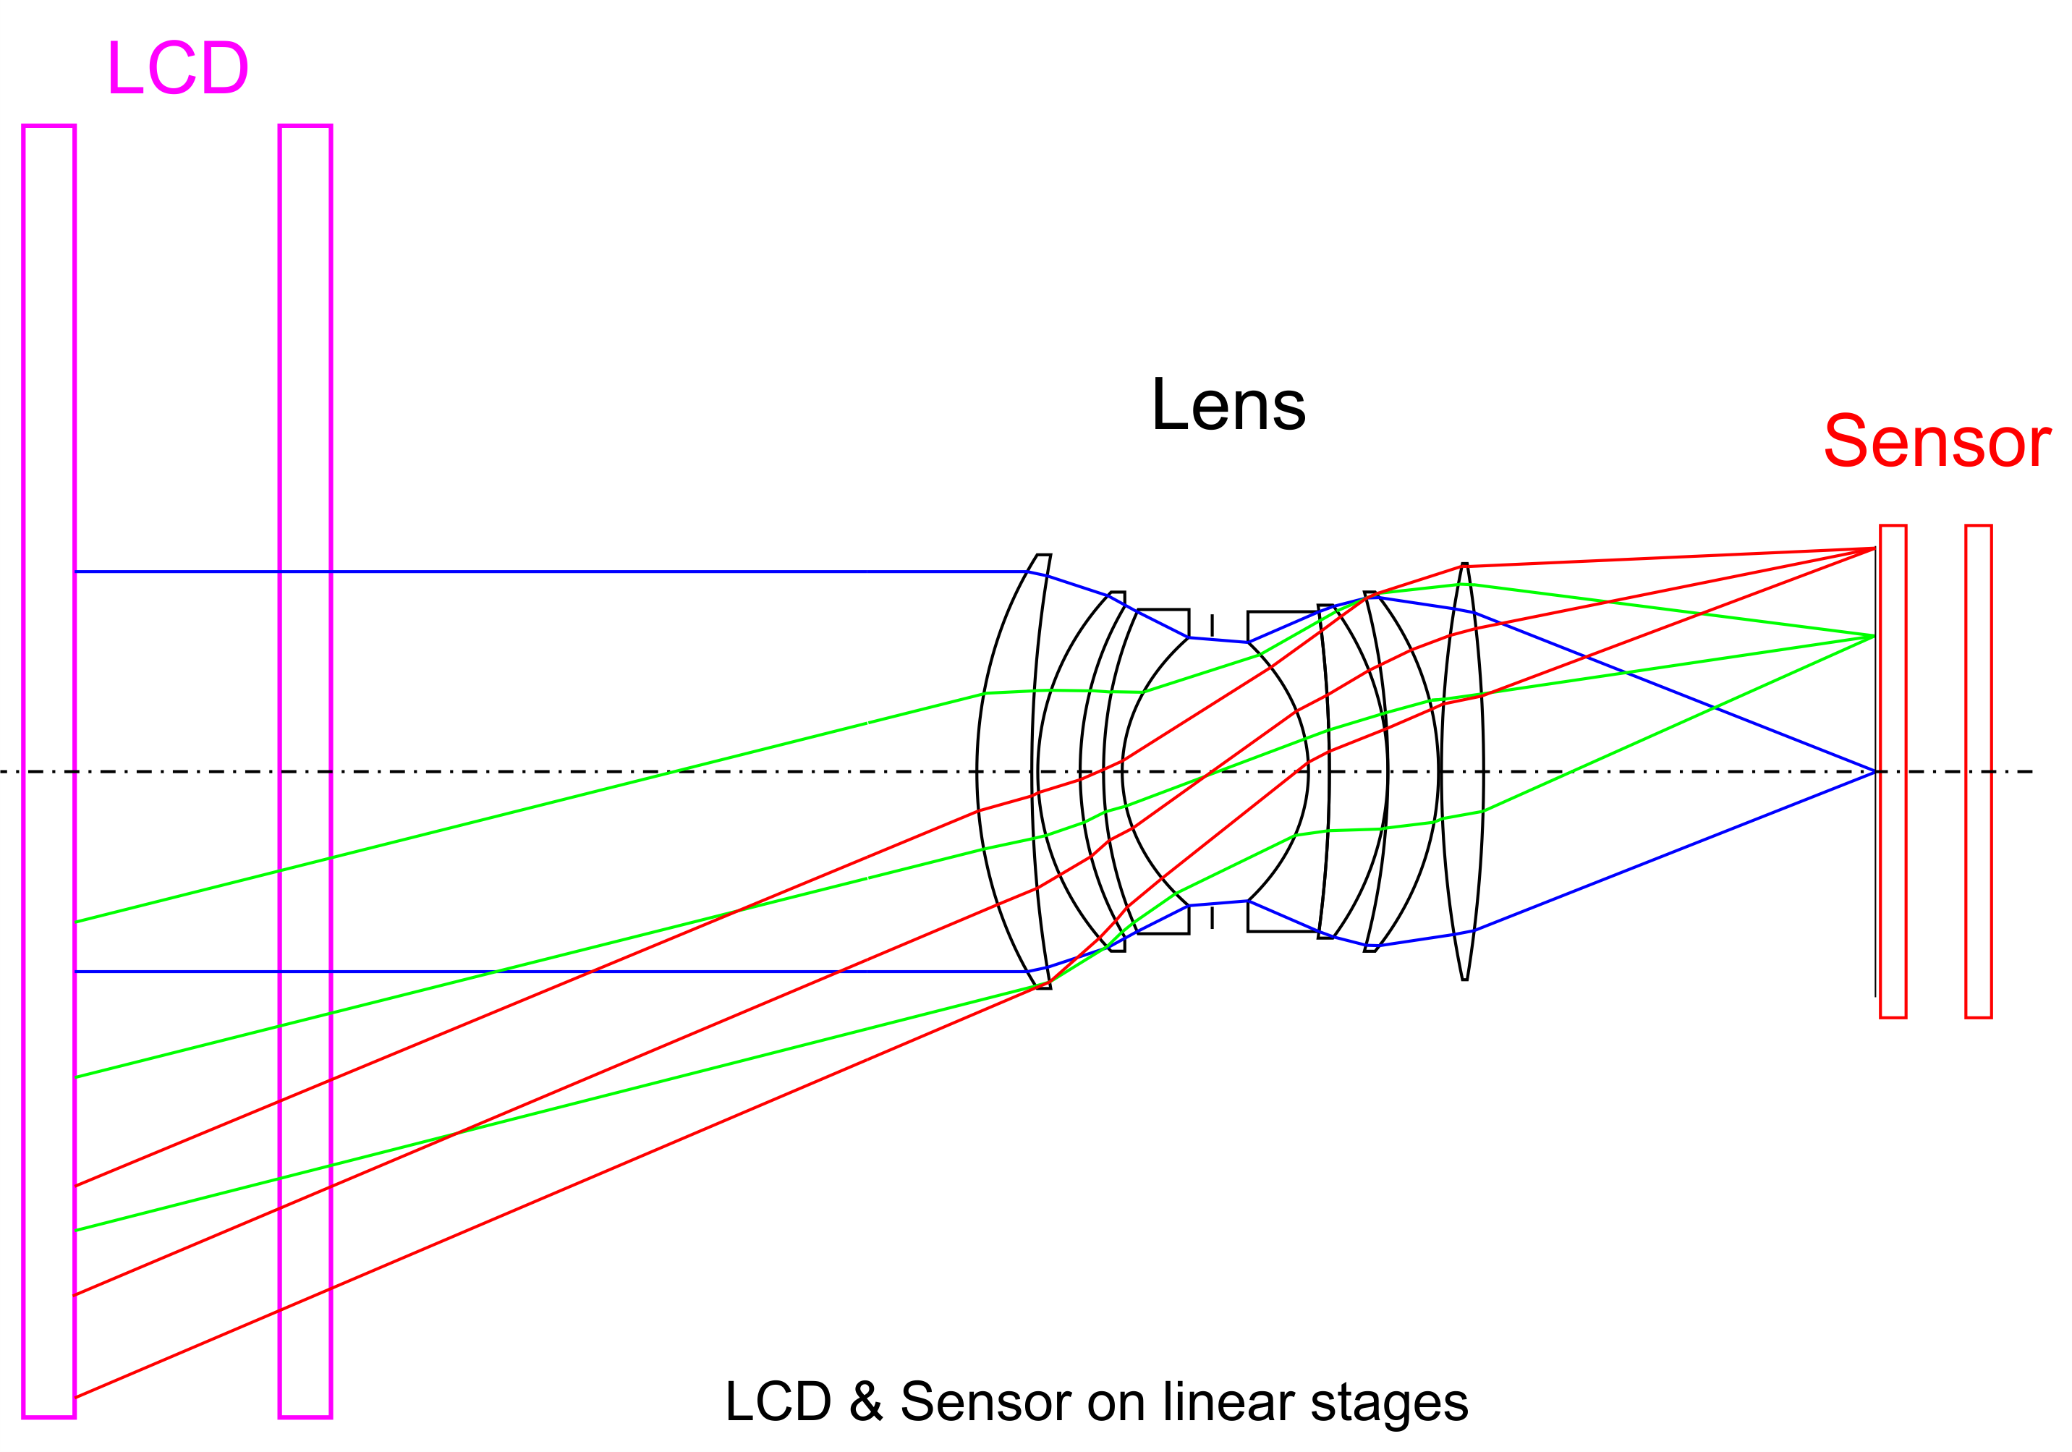
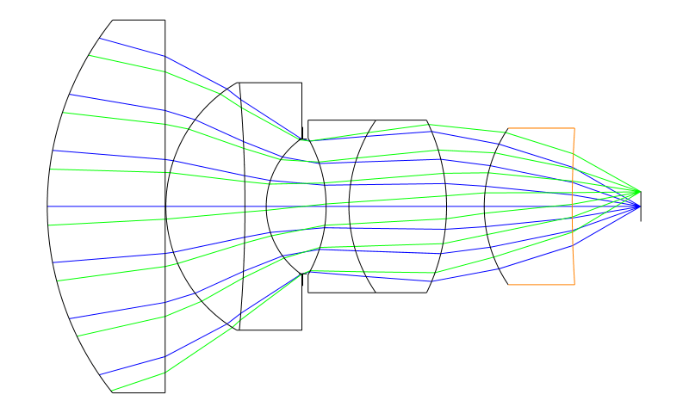
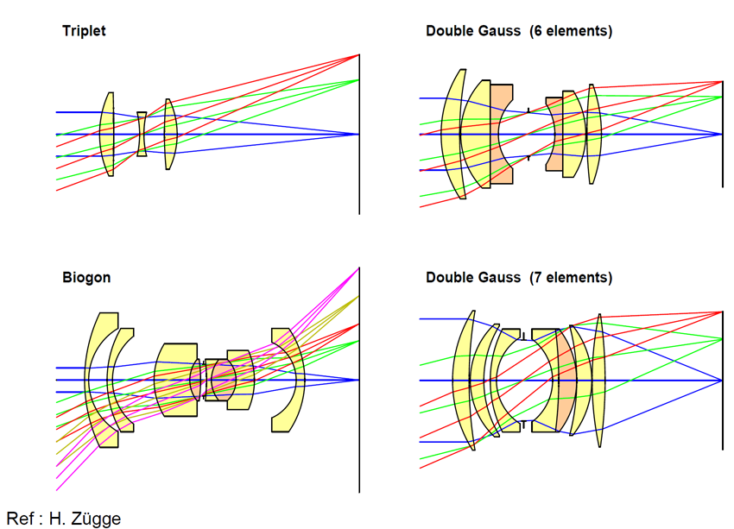
Pixel Ray Tracing for Close-Loop Optics
Close-Loop Optics: design, manufacturing, verification and defects examination
Notes:
Micro-positioning stage

Slide 46
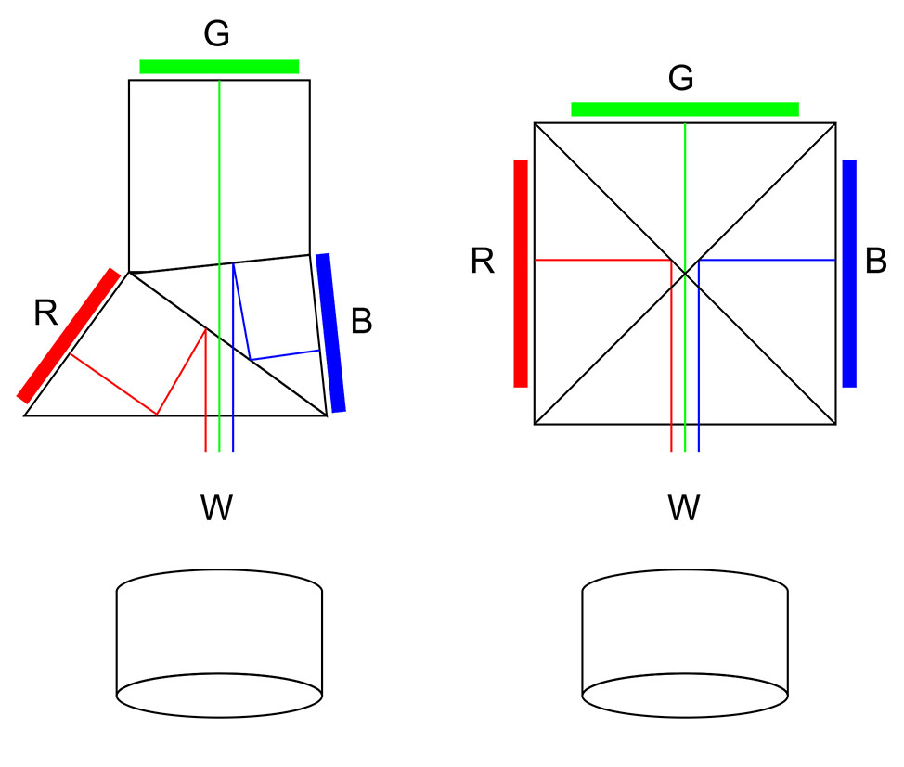
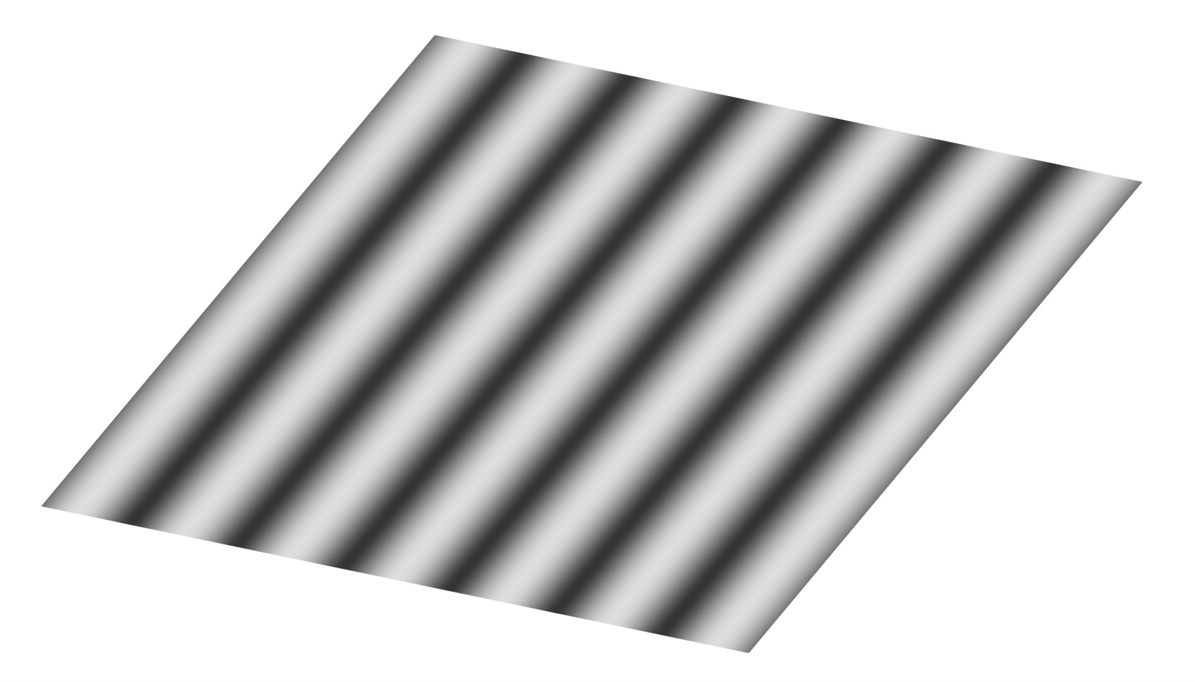
3-Chip Sensor or Imager
TIR
X-Cube
Cameras with 3-chip sensors
  Calibration
    The 6-DOF mounting errors of the 3 chips
    The distortion caused by the lens
  Resample the captured images
  Display and save the distortion-free images
Projectors with 3-chip imagers
  Indirect calibration by one or two calibrated cameras
  Resample the R,G,B channel images before projection
  Show the distortion-free images on screen
LCD
LCD

Slide 47
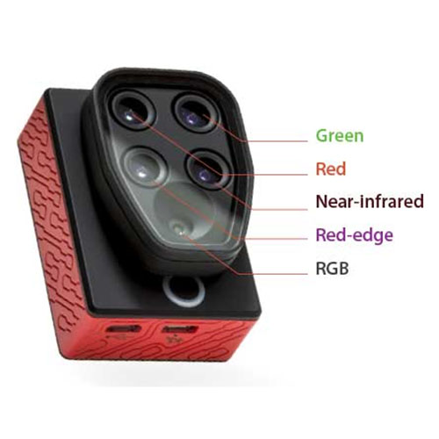
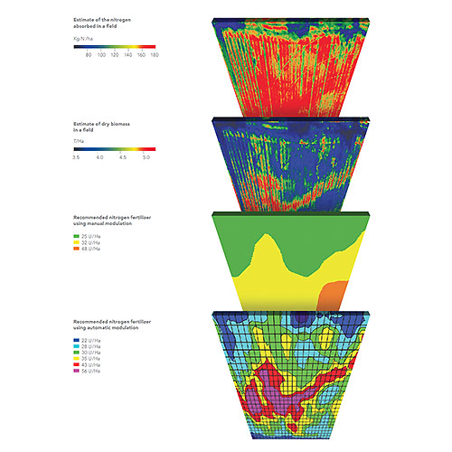
Multispectral Cameras
Multispectral camera
Multiple sensor: B, G, R, Red edge, IR,Thermal, etc.
Calibration can make all the pixels of different sensors and spectrum be matched exactly at the accuracy of 1/1,000 pixel pitch or better.

Slide 48
Virtual Sensors in Coordinate Systems
Cartesian Coordinate System
Polar Coordinate System
Cylindrical and Spherical Coordinate System
Notes:
Cartesian Coordinate System
Polar coordinate system, Cylindric coordinate systems
Spherical coordinate systems

Slide 49
Typical Applications
Non-touch 2D ruler.
Non-touch 3D ruler.
Angle measurement.
Remote distance measurement.
Telecentric lens.
Hypercentric lens.
3D printer with DLP Light exposure.
HEL (High Energy Laser Beam Director).
Geometry verification.
Defect inspection.
Machine vision, 2D & 3D.
Dual arm robot dual-view.
Urobot under water 3D measurement, rescure, repair.
Warehouse dispatching and packaging.
Robot palletizer.
Production line part recognization, pickup.
Projector.
Short-throw TV.
Laser MEMS projector.
Laser Imager.
Prepress exposure.
Circuit board exposure.
Airborne survey and measurement.
UAV camera image stabilization.
UAV ground target tracking.
Marine hydrology,hydrogeololgy.
Biology cell microscope.
Notes:
High Energy Laser (HEL) Beam Director.
Packaging System included wrapping around cases , palletizer, robot palletizer, etc.

Slide 50
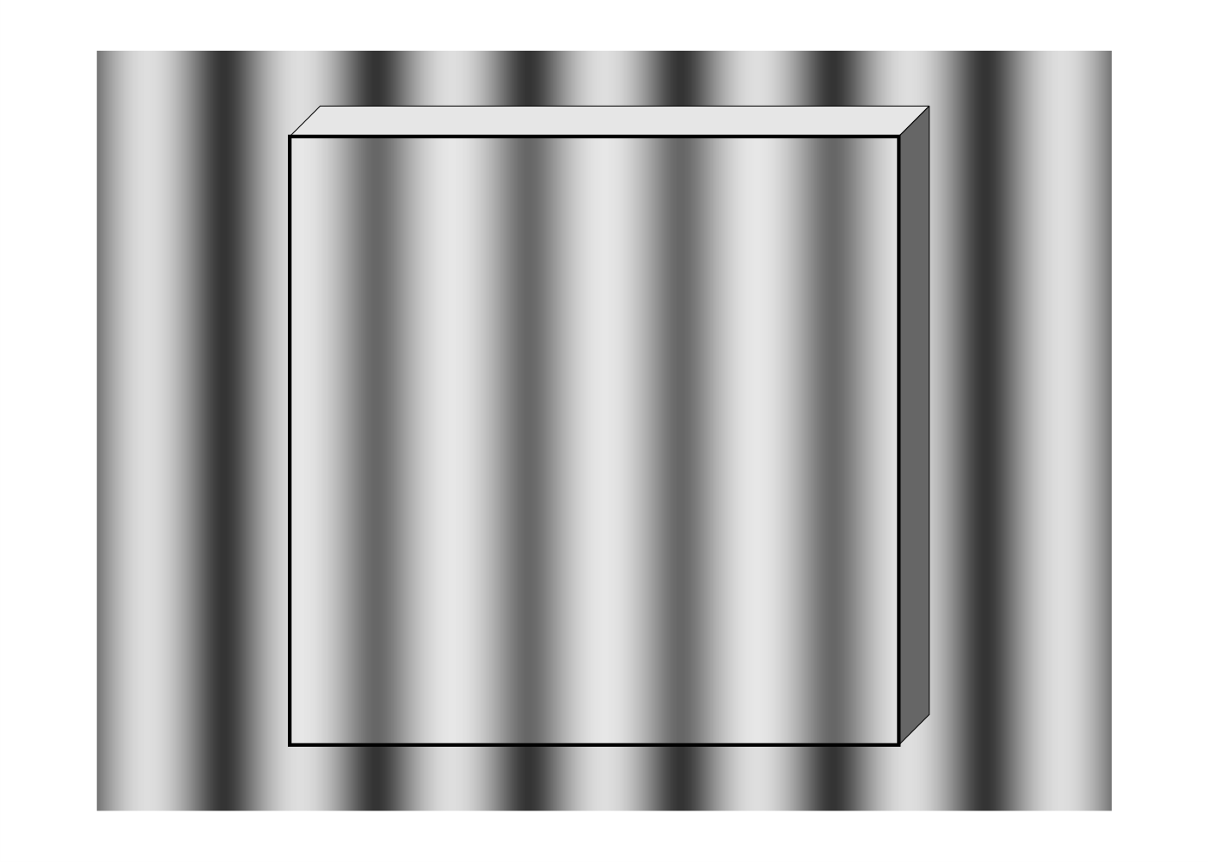

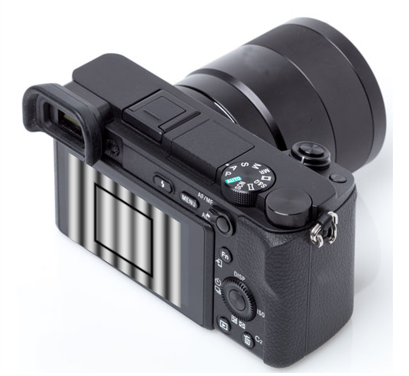
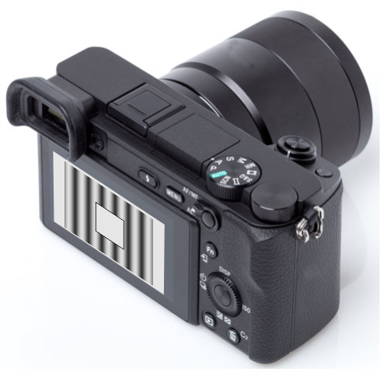
Glass Quality Inspection
Y
0
X
Z
Z'
Glass thickness and defects detection
Glass surface smoothness inspection
Notes:
Glass Thickness and Defects Detection:
The glass to be measured can be put in front of the LCD
Global low frequency distribution is the reference.
Any defects can be found by checking the high frequency changes of the phase map
Camera calibration may not be required
Surface Flatness Inspection:
Phase Measuring Deflectometry (PMD)
Reflecting Fringes
Surface flatness
Surface smoothness
Standard part as reference
Surface differential errors

Slide 51
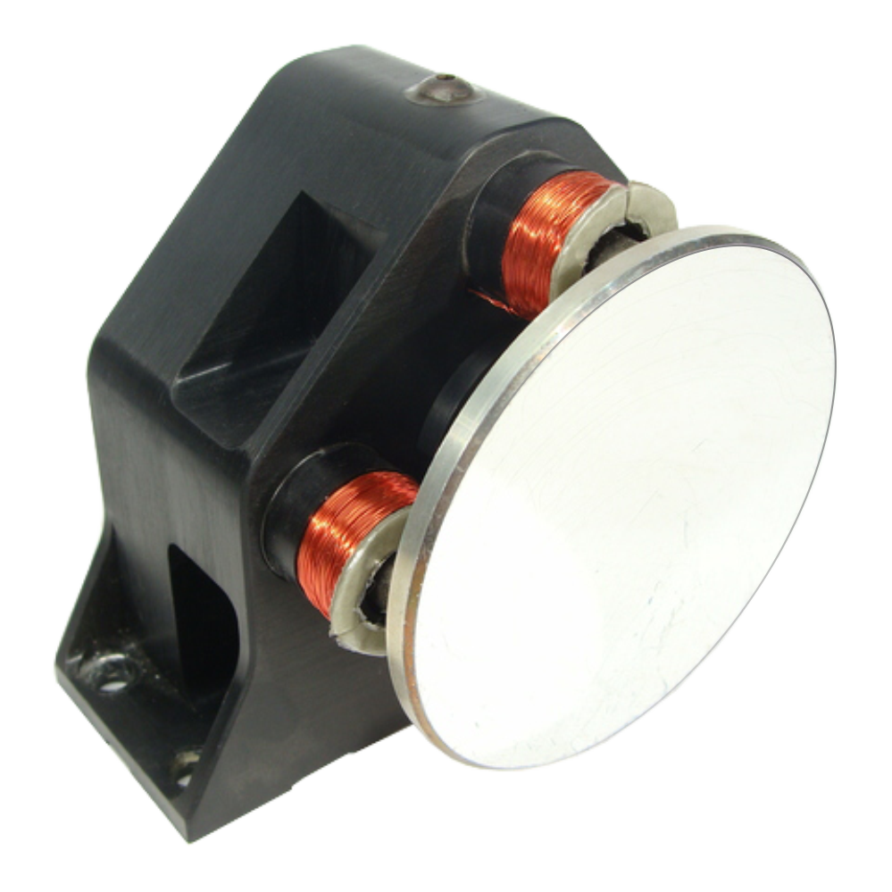
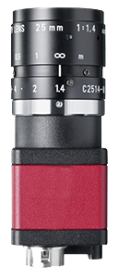
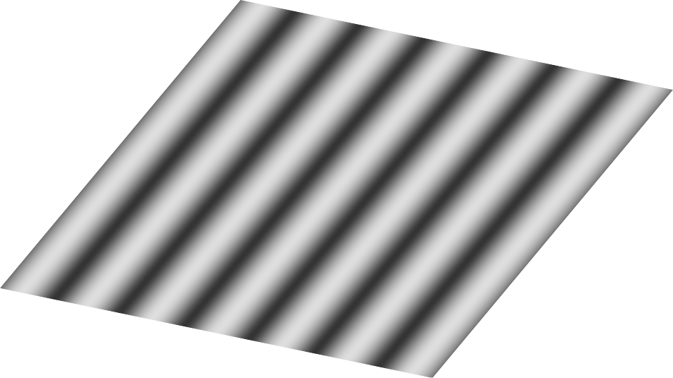
FSM Calibration
FSM
(α, β)
Camera calibration
  Set the FSM pitch, yaw angular position to (α, β) = (0, 0)
  Calibrate the camera to get the Pixel Rays and the Virtual Sensor
FSM calibration
  Capture images with the FSM at different angles (α, β)
  Using the images, get the SOV (Sight of View) locations (x, y, z) and the image rotate angles (θ)
  Using the location data to
    Get the FSM rotation center on the world coordinate system
    Get the normal vector matrix of the mirror surface on the world coordinate system
  Fit the error distribution matrix
FSM error model and error compensation
  Accurately point the light/beam to the target (for light pointing applications)
  Accurately get the target angular direction(for target tracking applications)
O_{C}
O_{M}
Camera
_{or HEL}
SOV
O_{W}
LCD
FOV
@(0, 0)
FOV
@(α, β)

Slide 52
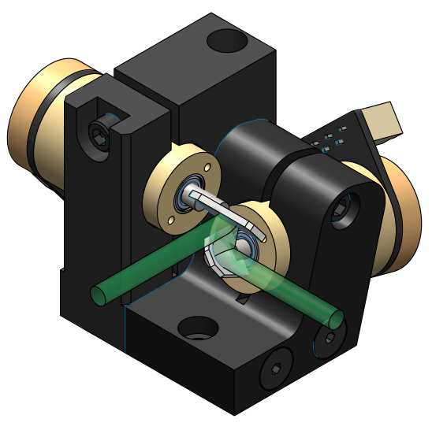


Galvo Calibration
Galvos calibration with a calibrated camera
  Intensity controllable LED/Laser light sources
  Line and field scanning of galvo mirrors
Pattern Engine
  The combination of light intensity and the galvo line/field scanning can generate fringe patterns
Laser Doppler Vibrometer (LDV)
  3D Continuous Scan Laser Doppler Vibrometer (3D CSLDV)
Laser Scanning Confocal Microscope
3D Printer
Galvo
Galvo with f-θ lens

Slide 53

Phase Measuring Deflectometry (PMD)
Calibration
  Using a first surface mirror as the reference
  Get the Pixel Ray Vector Set
Measurement
  Specular free-form surface
  Sub-nano accuracy
  Compare with the design CAD
Surface defects detection
  Mirror or glass surface
  Compare with standard products for surface differential
  Areas with high frequency variations
Notes:
Phase Measuring Deflectometry (PMD) is an approach to measure specular free-form surfaces.
deflectometry
Industrial quality inspection
It complements conventional approaches to qualitative inspection with a quantitative measurement approach and enables robust recognition and assessment of defects.

Slide 54

Precision Balls for Indirect Calibrations
Surface point cloud can be got by a 3D scanner.
Ball center can be fitted by the point cloud.
  High accuracy: The accuracy of the fitted ball center can be a few orders of magnitude higher than that of the surface point cloud.
  Normal vector: 3 points can determine a plane and a normal vector in space.
Single ball for space vector measurement
  For linear axis: Fit a ball's center at 2 or more locations.
  For rotating axis: Fit a ball's center at 3 or more angular locations.
3 balls for 6-DOF movement measurement
  The 6-DOF movement of an object in space can be determined by tracking the 3 points.
3 balls as reference for 3D point cloud stitching
  2 sets of 3D point cloud can be stitched together with the reference.
  The stitching accuracy is very high.
  No reference stickers are needed to realize true non-contact measurement.
  Robot automatic 3D scanning for huge objects.
V_{N}
V₁₂
B₂
B₁
B₃
V₁₃
Notes:
Precision ball & Gauge block for quality control.
3D Scanner can get the ball center with much higher accuracy than that of the point cloud.
Applications:
Gimbal Platforms
Pan-tilt-Azimuth
Pitch-Roll-Yaw
Dynamic Image Stabilization

Slide 55
Precision and Accuracy Transfer and Magnification
LCD to Camera
  Statistic properties of precision and accuracy.
  Error Avg = 0, Std = 1/1,000 pixel pitch.
  Non-toutch 2D ruler
Dual-view vision
  Error Avg = 0, Std = 1/1,000 pixel pitch.
  Non-toutch 3D scanner or 3D ruler.
  3D Scanner or 3D-DIC.
Known precision geometry objects
  Ball or cylinder.
  Ball centers for 6-DOF measurement.
  Surface points fitted to ball center (accuracy enhancement).
Precision and accuracy
  2D/3D measurement to micron and even to nano meter level.
  Make the system accuracy up to its repeatability accuracy.

Slide 56





Backward Compatible with Pinhole Model
Y
0
X
Checkerboard
@6-DOF
Z
Board normal vector || Axis of linear stage
Approach 1:
Checkerboard corners are the reference points.
Checkerboard is at multiple 6-DOF locations.
Camera model - Pinhole Model.
  Intrinsic parameters
  Extrinsic parameters.
Approach 2:
The weight centers of the round dots are the reference points.
Board moves on a linear slider to 3+ z-locations.
Camera model - Pinhole Model.
  Intrinsic parameters
  Extrinsic parameters
Notes:
Classic Camera Calibration with checkerboard or calibration board with round dots.
Pinhole camera model approximating the camera's
Intrinsic parameters
Extrinsic parameters
WCS is on the checkerboard or the calibration board at z = 0.
The backward compatible pinhole model can be configured by the Virtual Sensor.
All error coefficients will be 0.

Slide 57
Conclusions
Advantages
  High accuracy for every pixel of both 2D image and 3D point cloud.
    The average error is 0.
    The std error is 1/1,000 of a pixel or smaller.
    Zero geometry aberration.
    Zero chromatic aberration.
  High speed.
    Fast camera calibration (in seconds to minutes).
    Zero delay real-time image rectification.
    Real-time 3D reconstruction.
  Multiple calibration.
    Geometry calibration and chromatic calibration with all LCD pixels as active reference points.
    Interactive intensity calibration with LCD as even lighting box and with the camera as the intensity meter.
    Any COTS LCD flat panel can be used.
Applicability
  The technique is universally applicable to all imaging devices with any types of lenses.
    Cameras (image sensing devices).
    Projectors (image projecting devices).
  Optic parts close-loop manufacturing.
    Millions of rays can be traced with the space accuracy of 1/1,000 of a pixel.
    Geometry properties of single lens or lens assemblies can be determined.
Notes:
COTS (commercial off-the-shelf)
Commercialization Readiness Level: 6

Slide 58
Tech Support
More details can be found at:
  MaySolutionsLLC.com/Support.html
Files can be downloaded:
  1. Camera_2.0_v0.99_2018_11_10.pdf
  2. Camera_2.0_v1.00_2020_02_10.ppt
Contact email:
  Bingcheng (Arthur) Yang <aYang@MaySolutionsLLC.com>
Notes:
http://www.maysolutionsllc.com/support.html

